Slide 1
Data Visualization
with Matplotlib & Seaborn
Prepared by: SO Vengleab · July 2026

Slide 2
Python for Data Visualization
Python provides a rich ecosystem of libraries designed to transform raw data into meaningful insights.
These tools allow for:
Informative & customized plots
Professional-grade aesthetics
Simple and effective data storytelling
Matplotlib
The foundational library for static, animated, and interactive visualizations in Python.
Seaborn
Built on top of Matplotlib, it provides a high-level interface for drawing attractive statistical graphics.

Slide 3
Setup Data

Slide 4
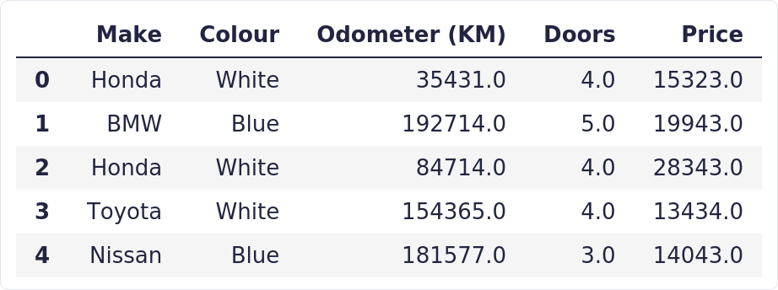
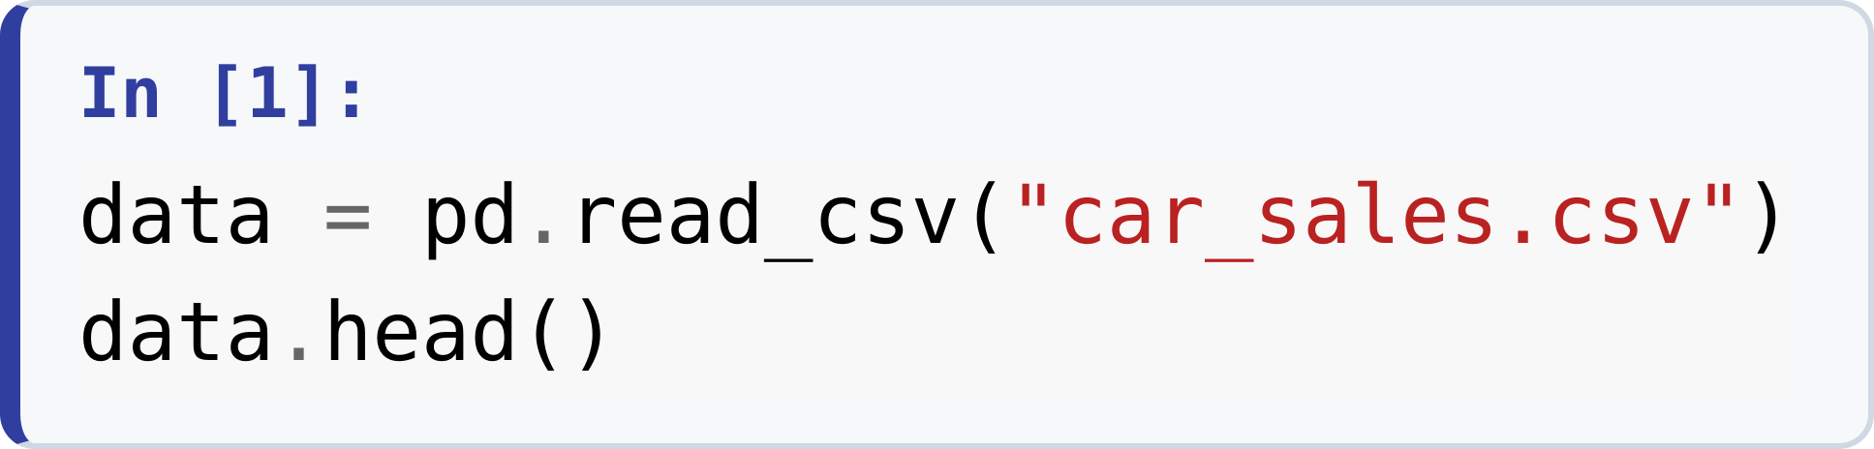
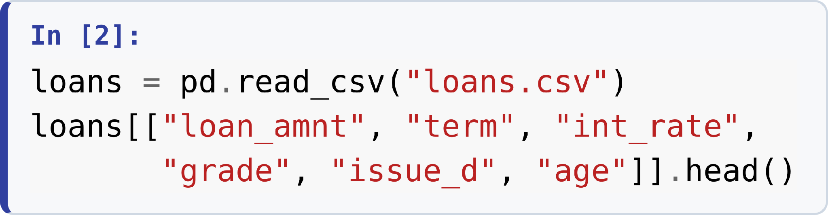
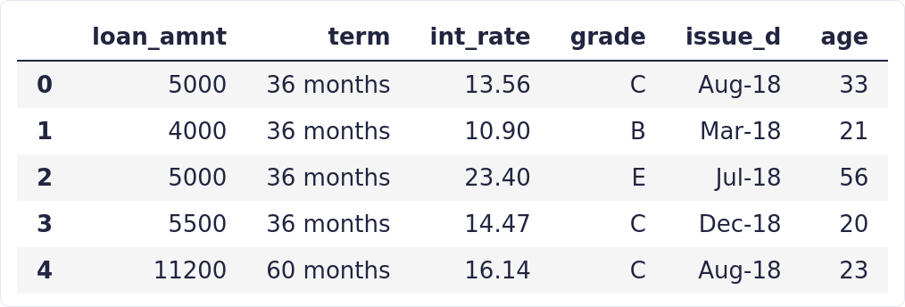
Our Two Datasets
USED IN EVERY EXAMPLE TODAY
Load once, plot all lecture
Notes:
data = pd.read_csv("car_sales.csv")
data.head()
loans = pd.read_csv("loans.csv")
loans[["loan_amnt", "term", "int_rate",
"grade", "issue_d", "age"]].head()

Slide 5
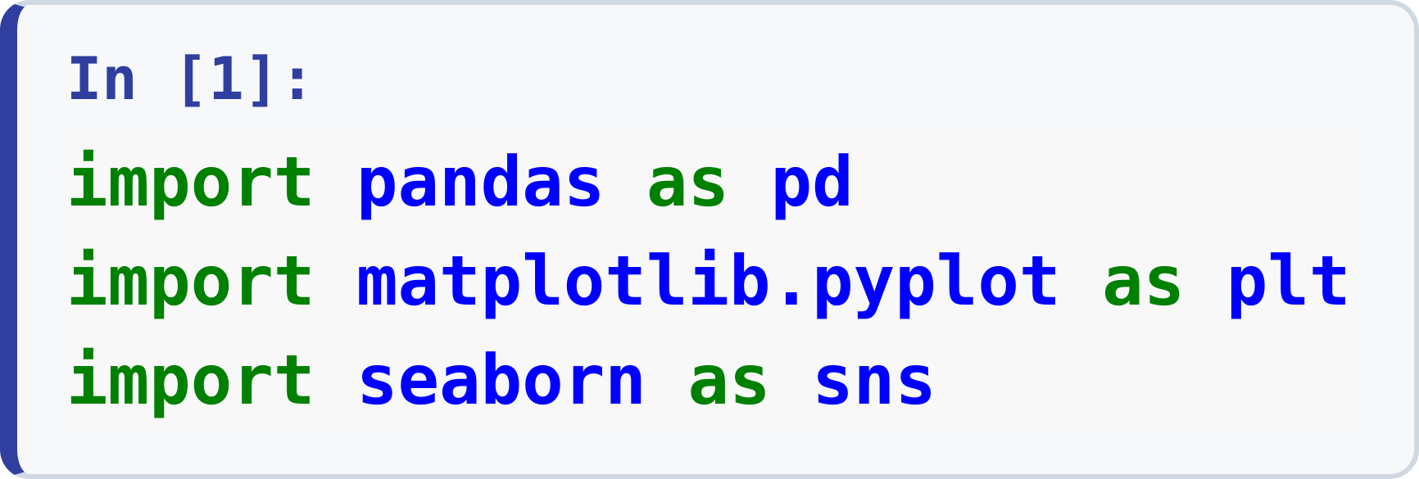
Setup
00 · FOUNDATIONS
pandas loads and reshapes the data — every plot starts from a DataFrame.
matplotlib.pyplot (alias plt) is the drawing engine; fig, ax = plt.subplots() gives you a figure and its axes.
seaborn (alias sns) sits on top of Matplotlib — every Seaborn chart is still a Matplotlib figure, so plt.show() displays both.
Notes:
import pandas as pd
import matplotlib.pyplot as plt
import seaborn as sns

Slide 6
Bar Chart
SECTION 01
Compare a numeric total across categories — total sales price per car maker.

Slide 7
Bar Chart with Matplotlib

Slide 8
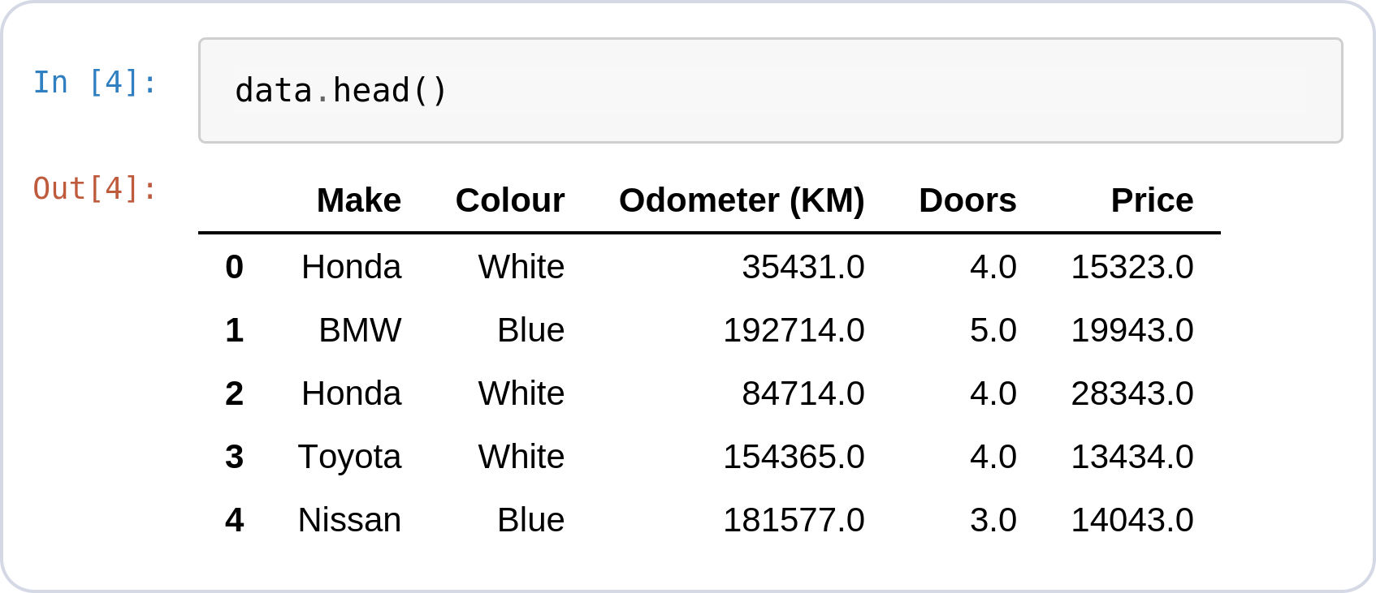
Why a Bar Chart?
BAR CHART · THE QUESTION
One row = one car sold
Reading the raw transactions, the overall performance of each manufacturer is invisible.
How many cars did each manufacturer sell, and how much revenue did each generate?
Which manufacturer sold the most overall?
● Insight: Group the rows by manufacturer, total the prices, and a bar chart answers all three at a glance.
Notes:
data.head()

Slide 9
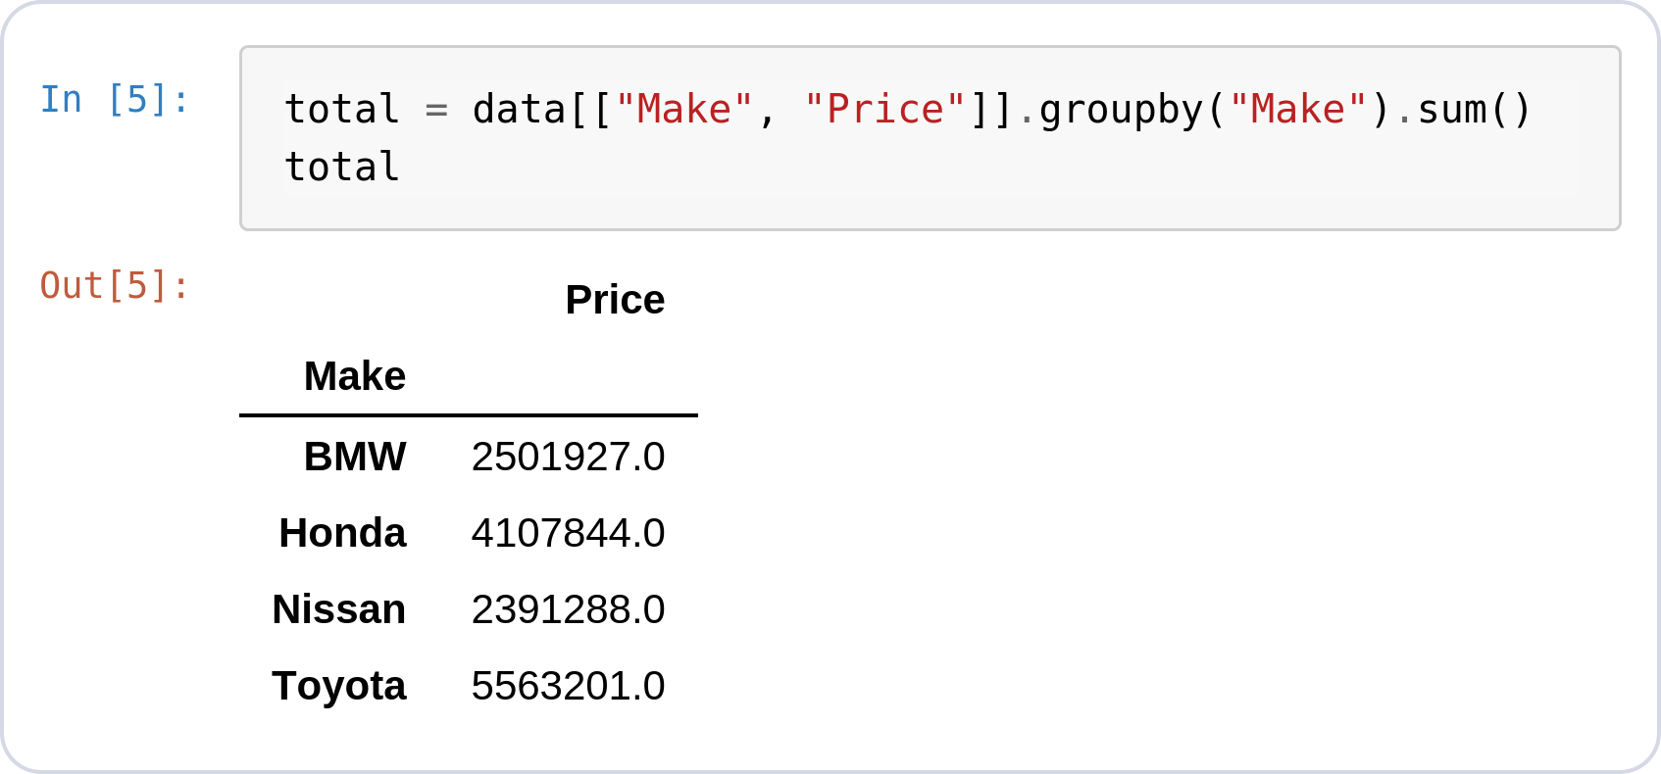
Prepare the Data
BAR CHART · MATPLOTLIB
Original → expected format
Matplotlib wants one number per bar.
groupby("Make").sum() turns 1,000 rows into 4.
● Insight: Remember this groupby — in a few slides Seaborn does it for you automatically.
Notes:
data.head()
total = data[["Make", "Price"]].groupby("Make").sum()
total

Slide 10
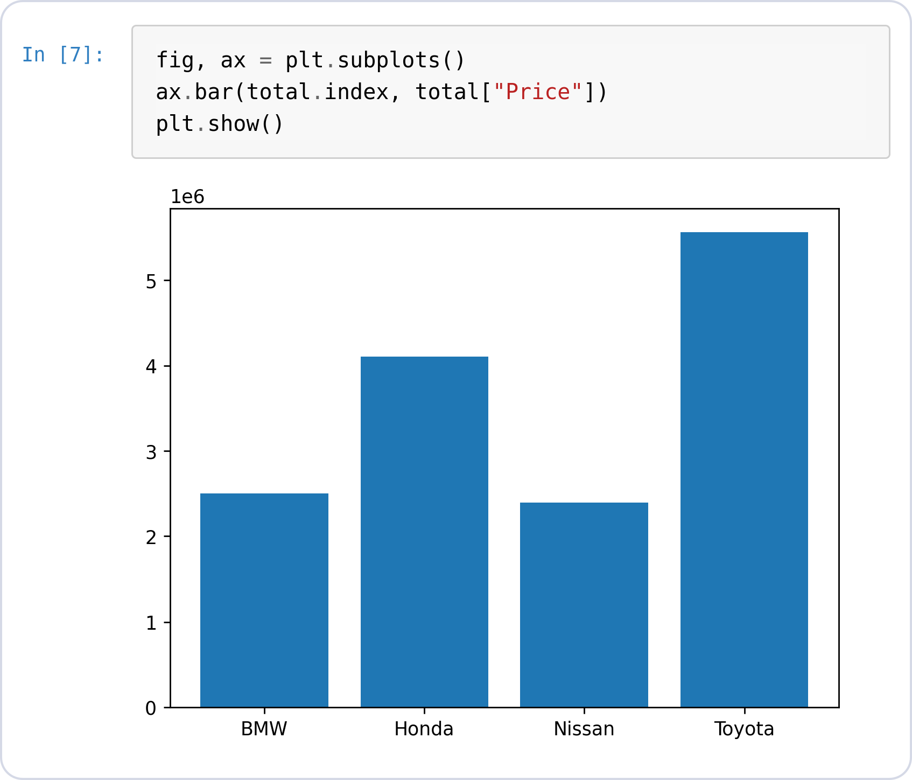
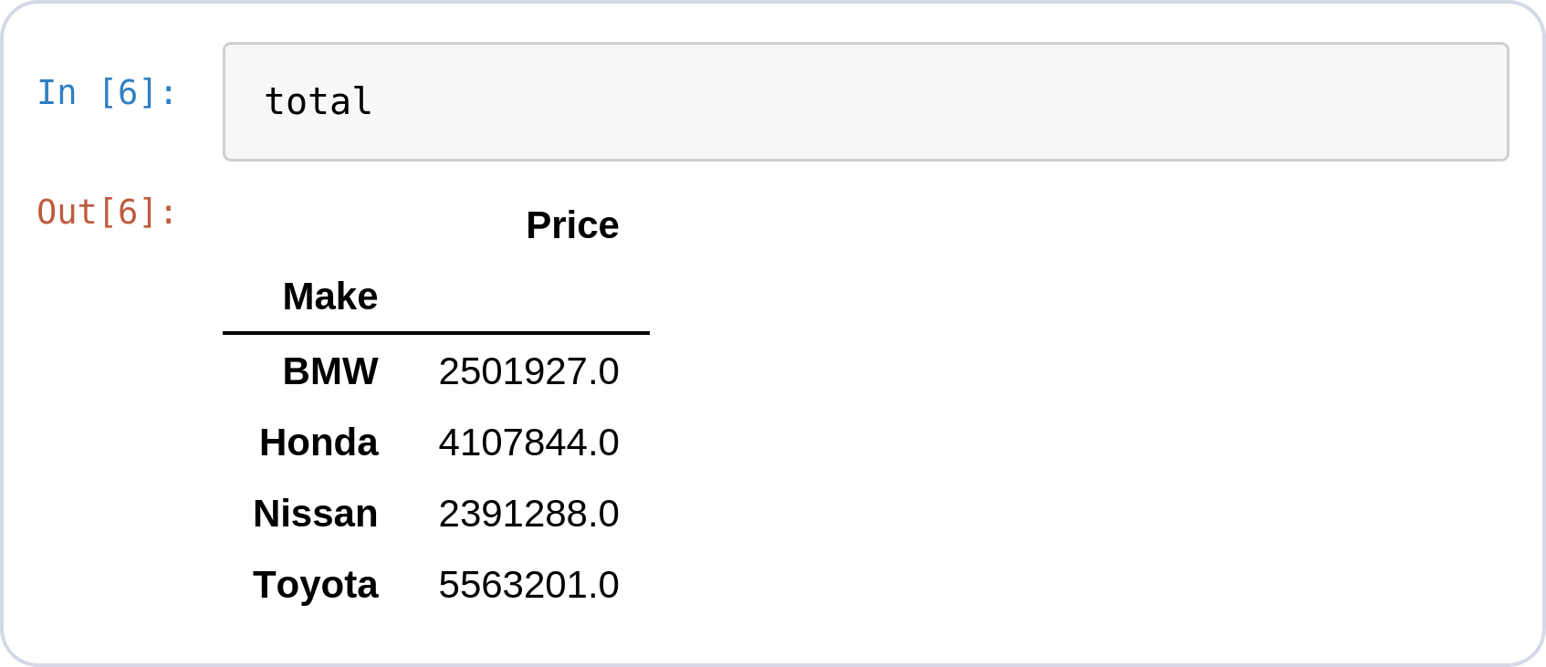
Bar · Basic Plot
BAR CHART · MATPLOTLIB
Plotting the aggregated table
ax.bar(x, height) — categories on x, totals as bar heights.
total.index holds the maker names, total["Price"] the sums.
plt.show() renders the figure.
Notes:
fig, ax = plt.subplots()
ax.bar(total.index, total["Price"])
plt.show()

Slide 11
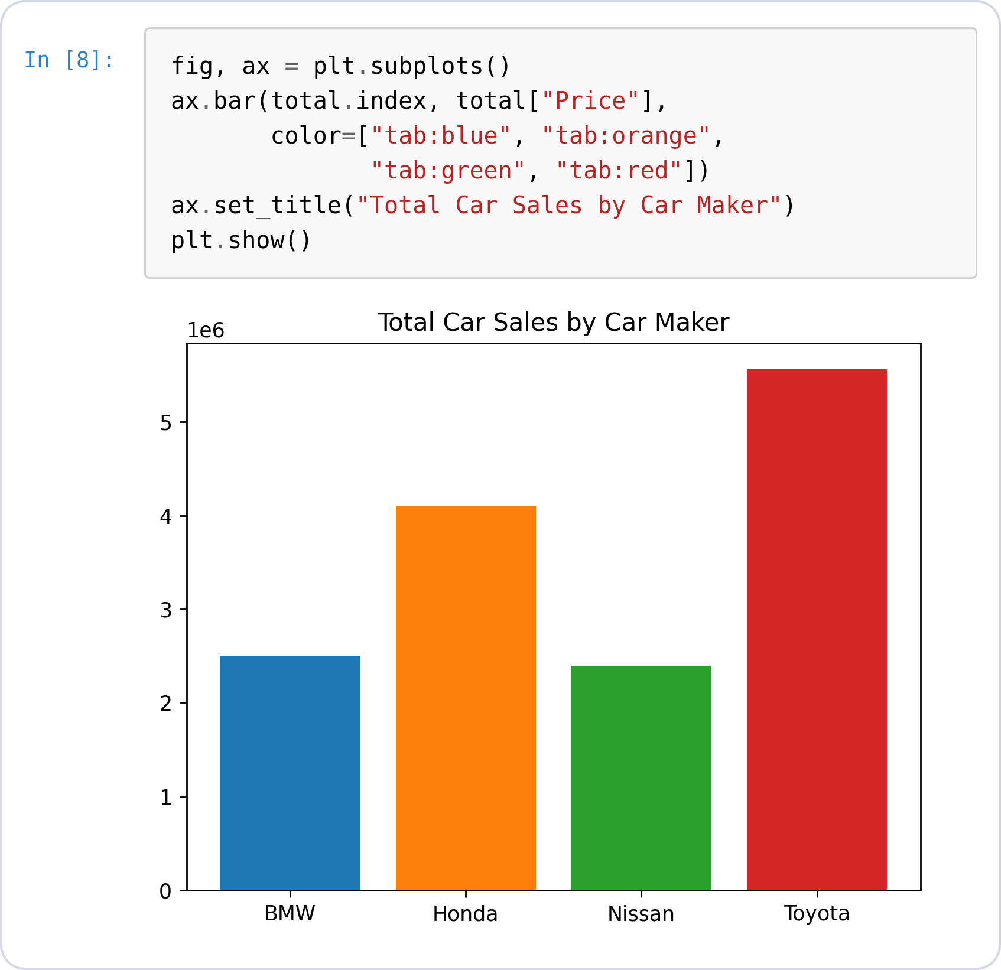
Bar · Colors & Title
BAR CHART · MATPLOTLIB
Styling is manual
color= takes one color per bar — you list them yourself.
ax.set_title() adds the headline.
Every styling choice in Matplotlib is an explicit argument.
Notes:
fig, ax = plt.subplots()
ax.bar(total.index, total["Price"],
color=["tab:blue", "tab:orange",
"tab:green", "tab:red"])
ax.set_title("Total Car Sales by Car Maker")
plt.show()

Slide 12
Bar Chart with Seaborn

Slide 13
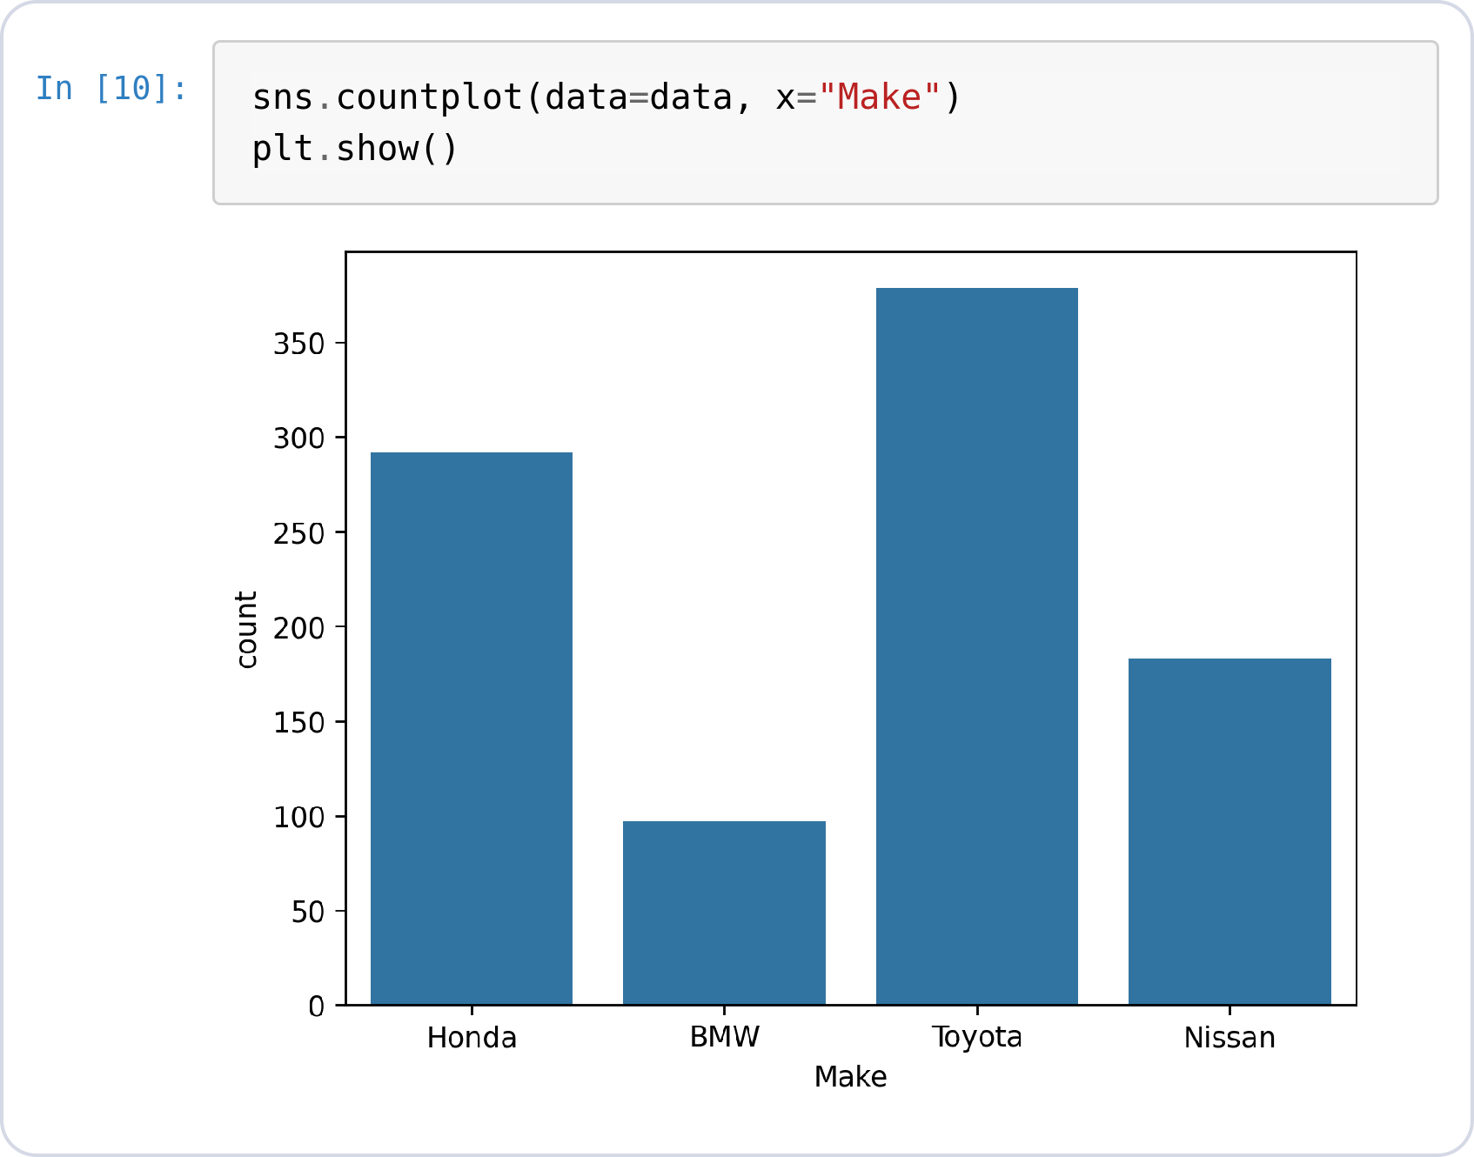
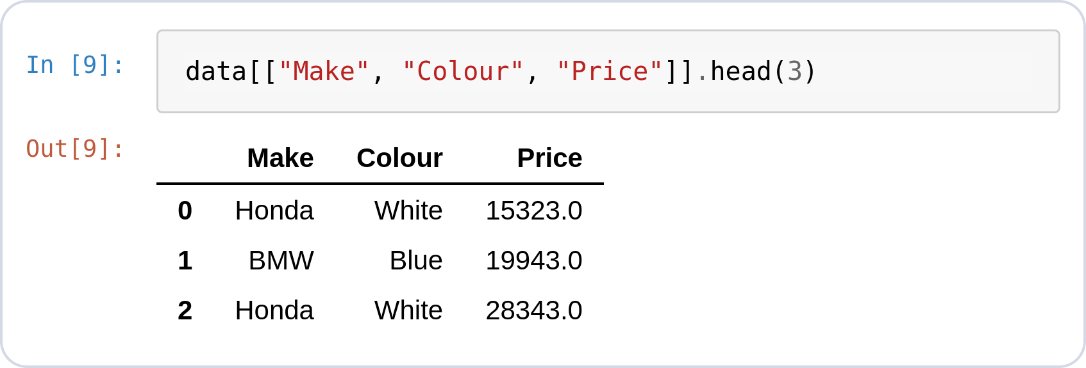
Seaborn countplot
BAR CHART · SEABORN
No data prep at all
sns.countplot takes the raw DataFrame — no groupby.
It counts rows per category itself and labels the axes.
The input on the left is the untouched raw table, not a summary.
Notes:
data[["Make", "Colour", "Price"]].head(3)
sns.countplot(data=data, x="Make")
plt.show()

Slide 14
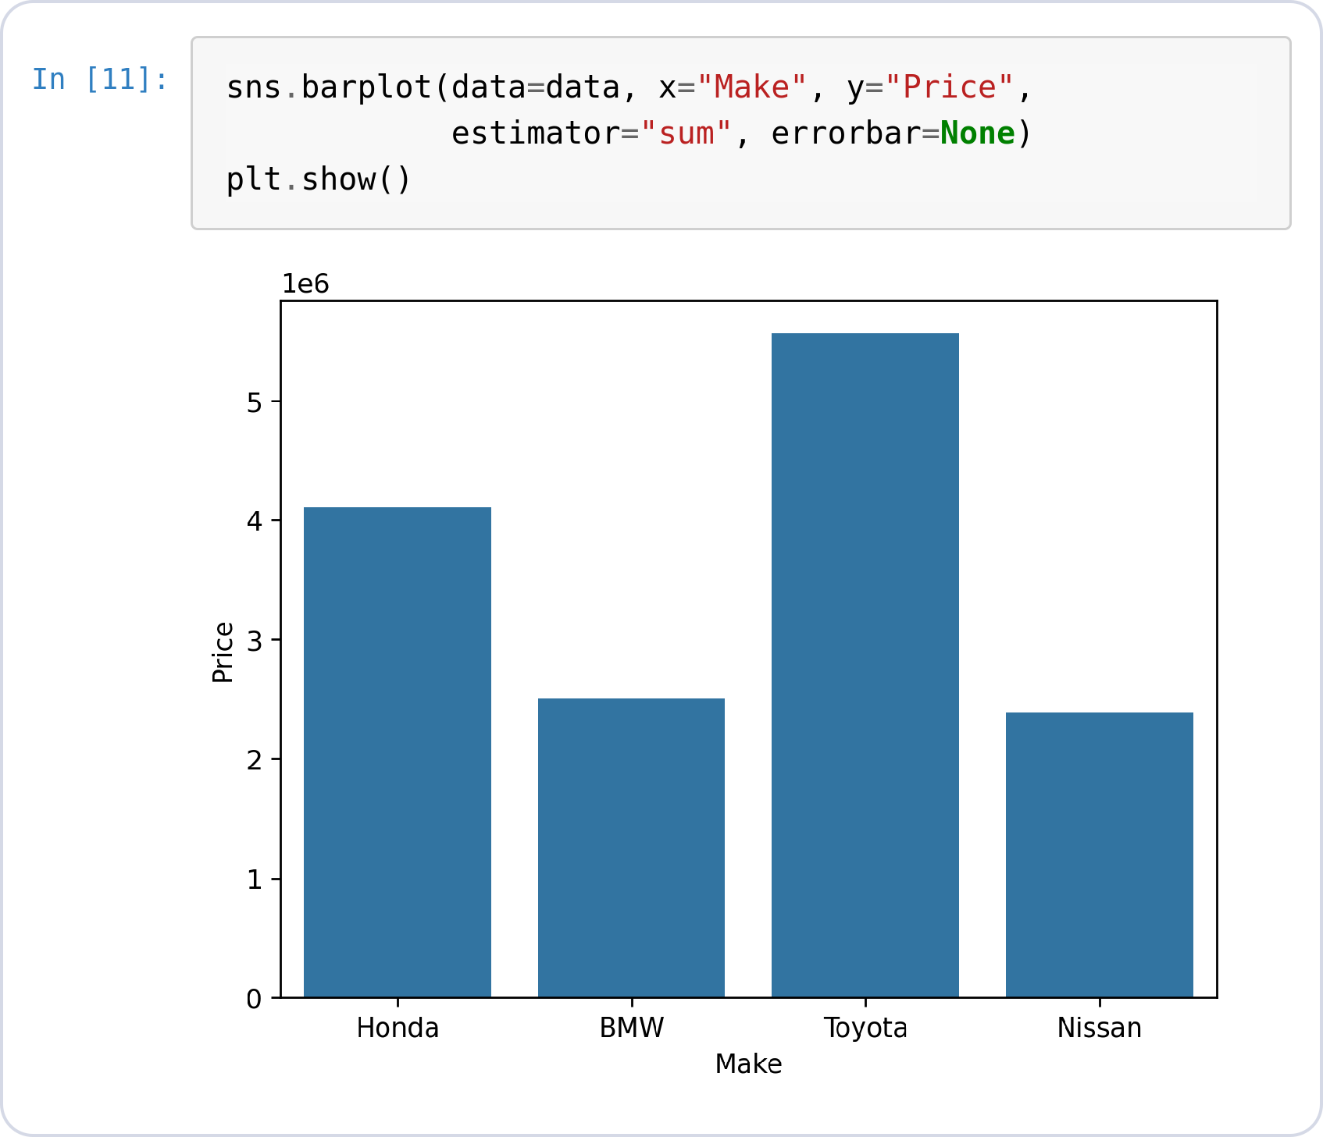
Seaborn barplot
BAR CHART · SEABORN
Aggregation built in
estimator="sum" tells Seaborn to total Price per Make — the groupby from earlier, done internally.
errorbar=None hides the uncertainty whiskers.
Same chart as Matplotlib's, from the raw rows on the left.
Notes:
data[["Make", "Colour", "Price"]].head(3)
sns.barplot(data=data, x="Make", y="Price",
estimator="sum", errorbar=None)
plt.show()

Slide 15
Pie Chart
SECTION 02
Share of a whole — each maker's slice of total sales. (Matplotlib only: Seaborn has no pie chart.)

Slide 16
Why a Pie Chart?
PIE CHART · THE QUESTION
The four maker totals
A bar chart compares sizes, but not each maker's share of the whole.
What percentage of total revenue does each manufacturer hold?
Does one manufacturer dominate, or is the market evenly split?
● Insight: When the parts must add up to 100%, a pie chart shows the split better than bars.
Notes:
total

Slide 17
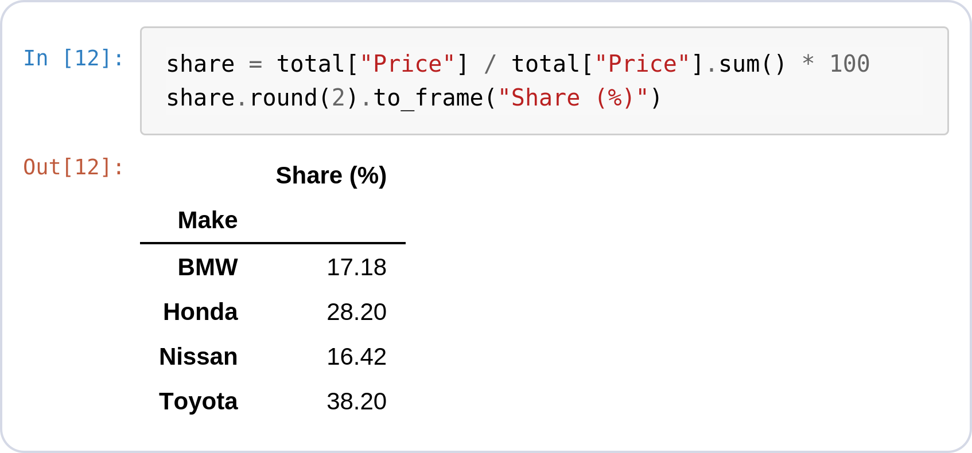
Prepare the Data
PIE CHART · MATPLOTLIB
Original → expected format
A pie needs one value per slice — total has it.
Each total ÷ grand total = share of 100%.
These are the numbers autopct will print.
● Insight: Toyota at 38.20% — watch for that exact number on the next slide.
Notes:
total
share = total["Price"] / total["Price"].sum() * 100
share.round(2).to_frame("Share (%)")

Slide 18
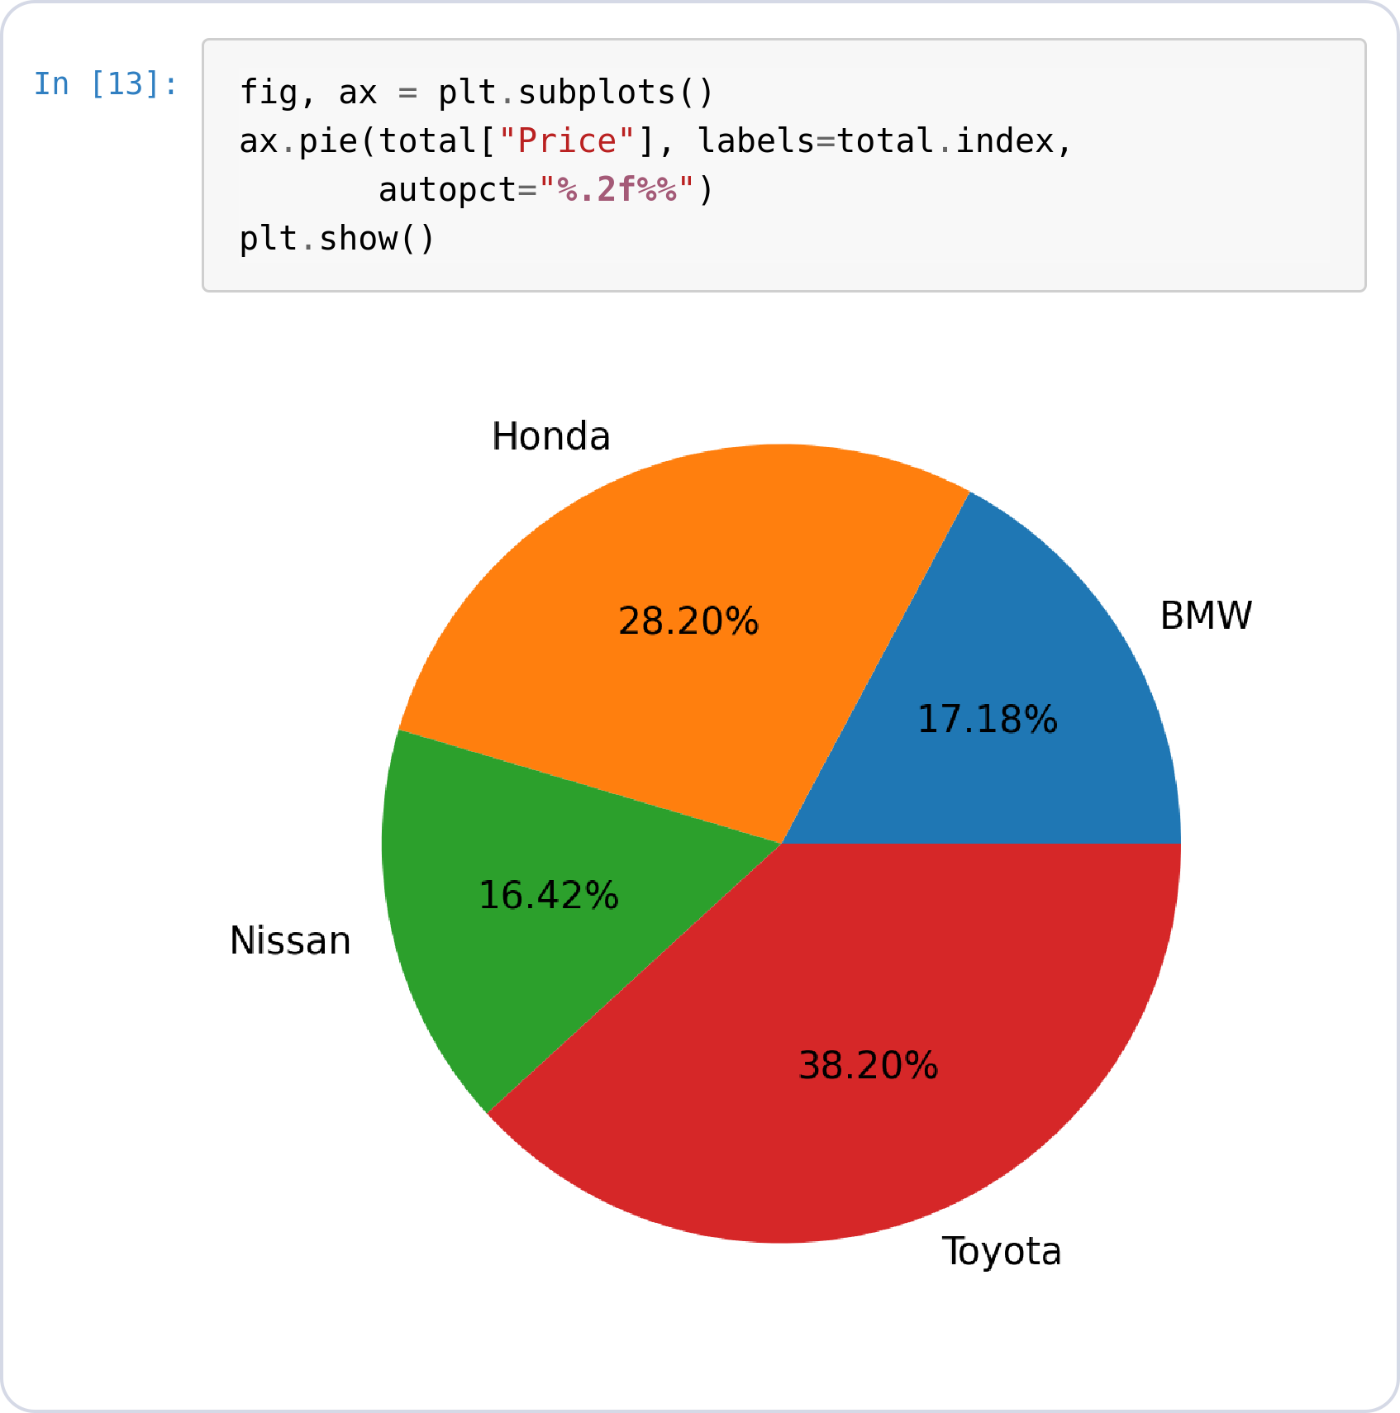
Pie · Basic Plot
PIE CHART · MATPLOTLIB
Same aggregated table
ax.pie(values, labels=...) — one slice per row of total on the left.
autopct="%.2f%%" prints the percentage on each slice.
Seaborn has no pie chart — pies stay a Matplotlib job.
Notes:
total
fig, ax = plt.subplots()
ax.pie(total["Price"], labels=total.index,
autopct="%.2f%%")
plt.show()

Slide 19
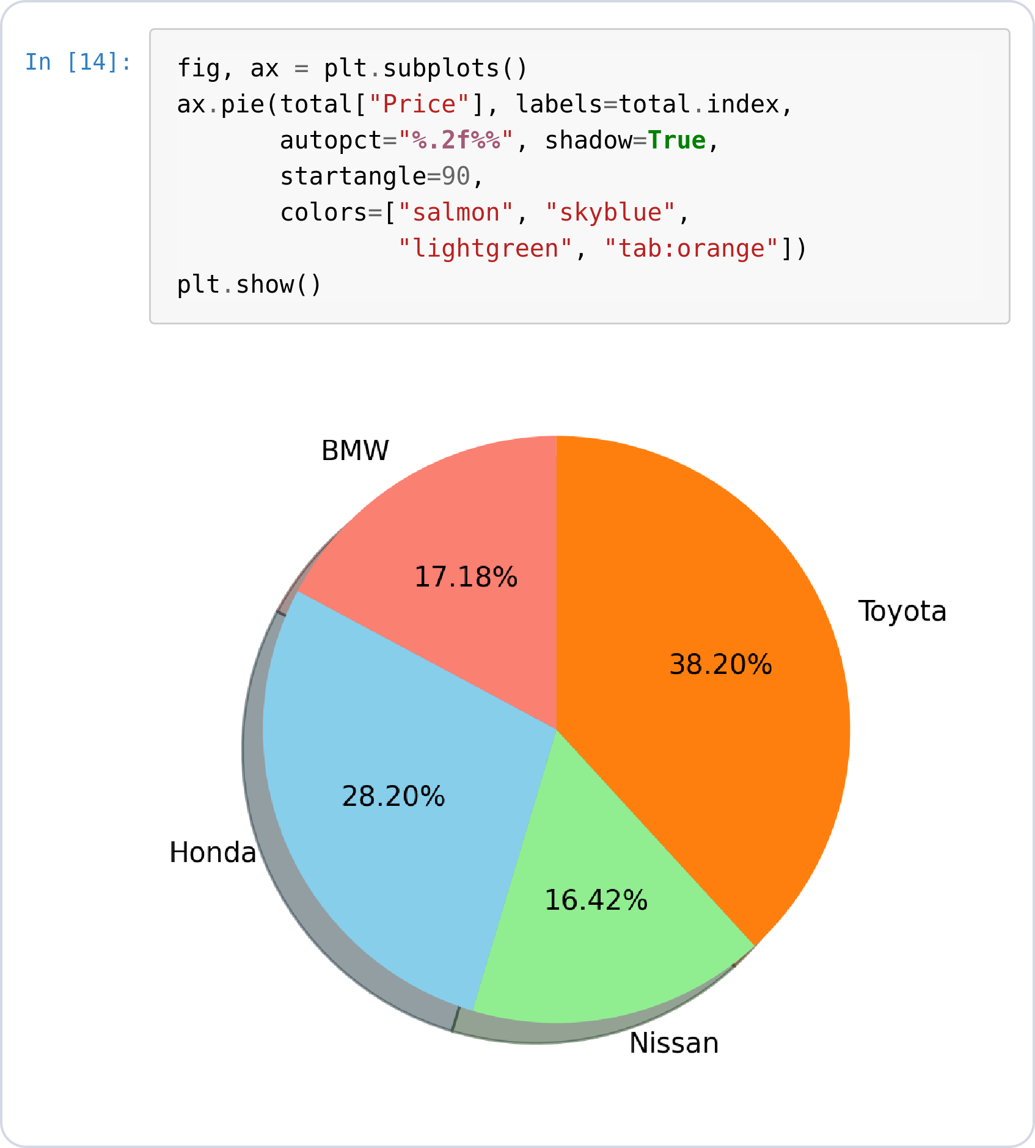
Pie · Styling
PIE CHART · MATPLOTLIB
Styling arguments
colors= sets one color per slice, in data order.
shadow=True adds depth under the pie.
startangle=90 rotates where the first slice begins.
Notes:
total
fig, ax = plt.subplots()
ax.pie(total["Price"], labels=total.index,
autopct="%.2f%%", shadow=True,
startangle=90,
colors=["salmon", "skyblue",
"lightgreen", "tab:orange"])
plt.show()

Slide 20
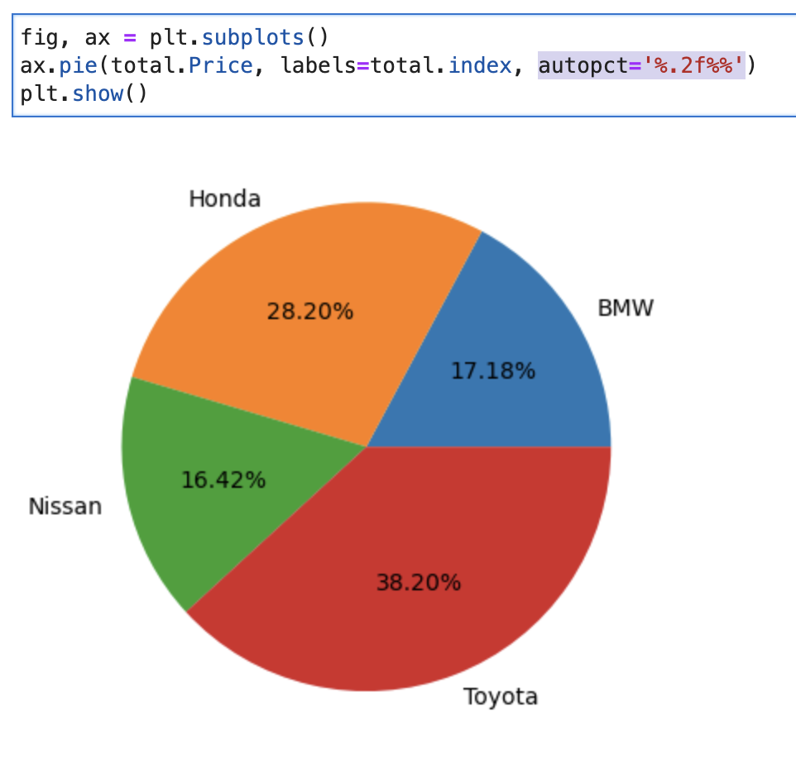
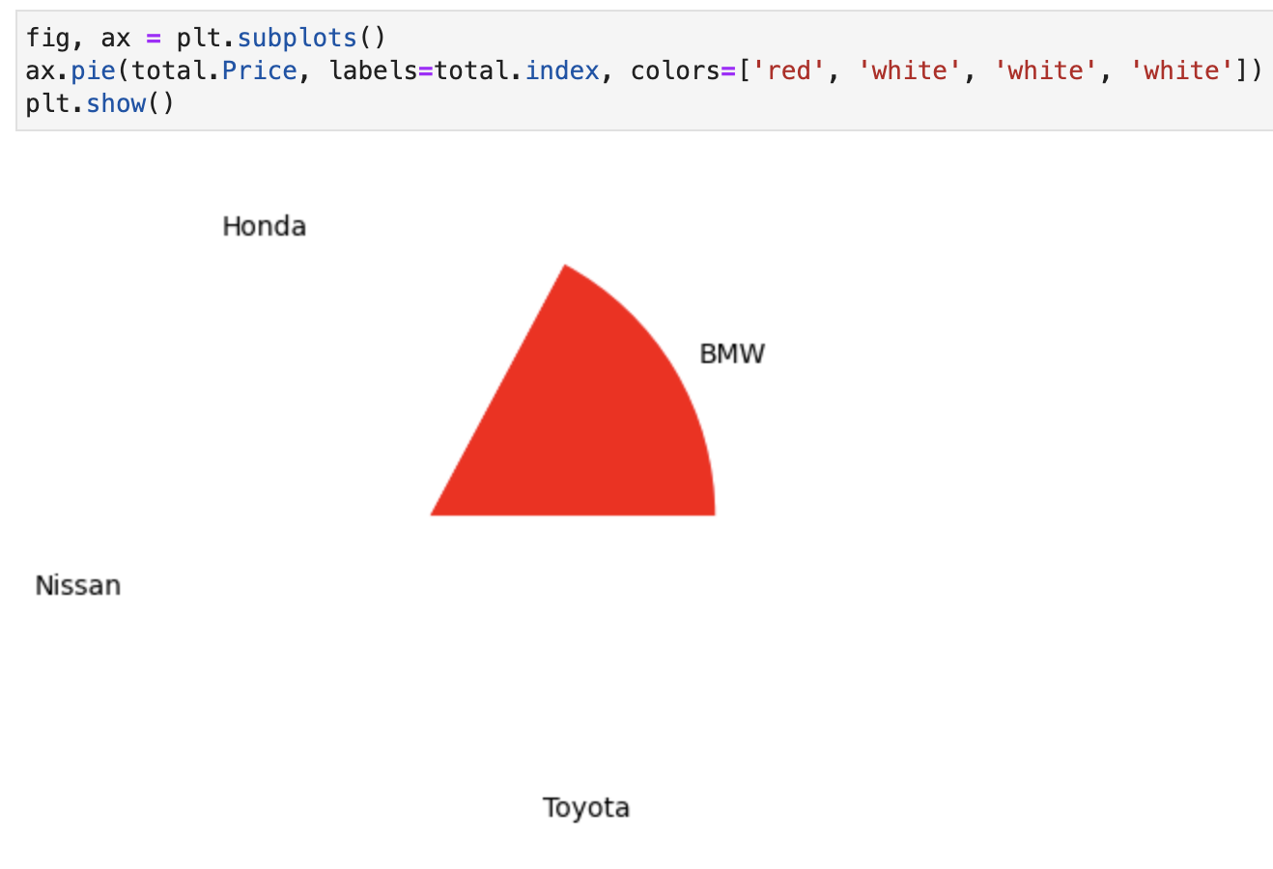
Auto Labeling
Coloring Slices

Slide 21
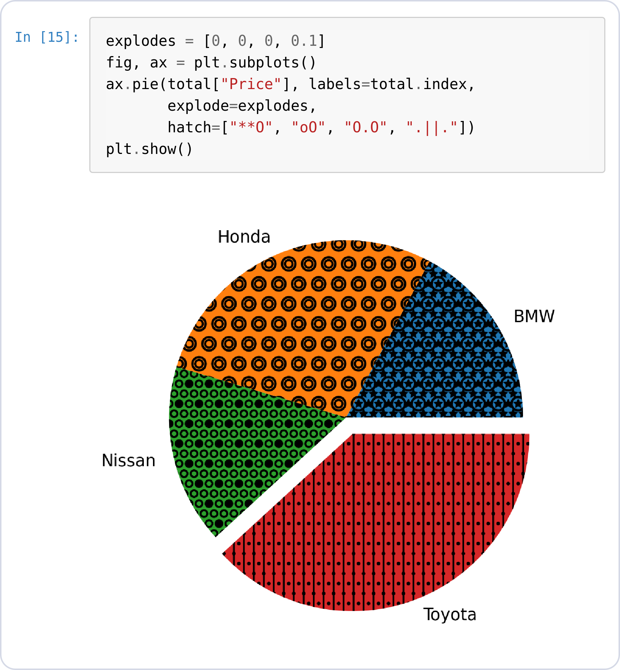
Pie · Explode & Hatch
PIE CHART · MATPLOTLIB
Highlighting one slice
explode offsets slices — here only Toyota (0.1) pops out.
hatch= fills each slice with a texture pattern, useful for black-and-white printing.
Notes:
total
explodes = [0, 0, 0, 0.1]
fig, ax = plt.subplots()
ax.pie(total["Price"], labels=total.index,
explode=explodes,
hatch=["**O", "oO", "O.O", ".||."])
plt.show()

Slide 22
Histogram
SECTION 03
The shape of one numeric column — how car prices are distributed.

Slide 23
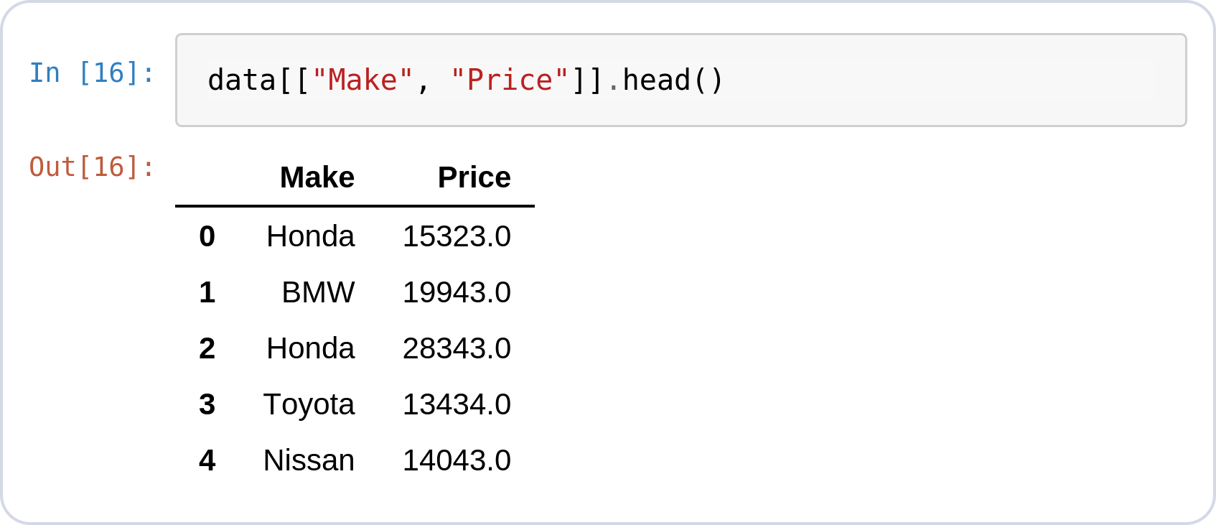
Why a Histogram?
HISTOGRAM · THE QUESTION
One column: 1,000 prices
A total or an average hides how the individual prices are spread.
What is a typical price, and are most cars clustered around it?
Are there a few unusually expensive cars pulling the average up?
● Insight: Bucket the prices into ranges and count each bucket — that count per range is a histogram.
Notes:
data[["Make", "Price"]].head()

Slide 24
Histogram with Matplotlib

Slide 25
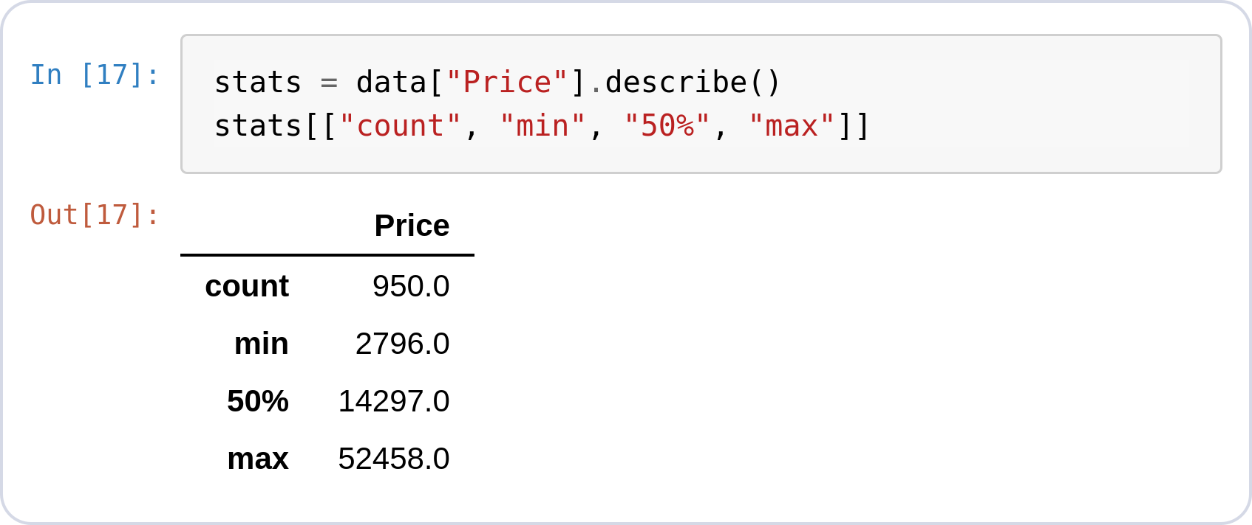
Prepare the Data
HISTOGRAM · MATPLOTLIB
Check the column first
One raw numeric column — no groupby needed.
950 prices, not 1,000 — 50 are missing.
Min 2,796, median 14,297, max 52,458.
● Insight: Both libraries skip the missing prices — but you should know they're there.
Notes:
data[["Make", "Price"]].head()
stats = data["Price"].describe()
stats[["count", "min", "50%", "max"]]

Slide 26
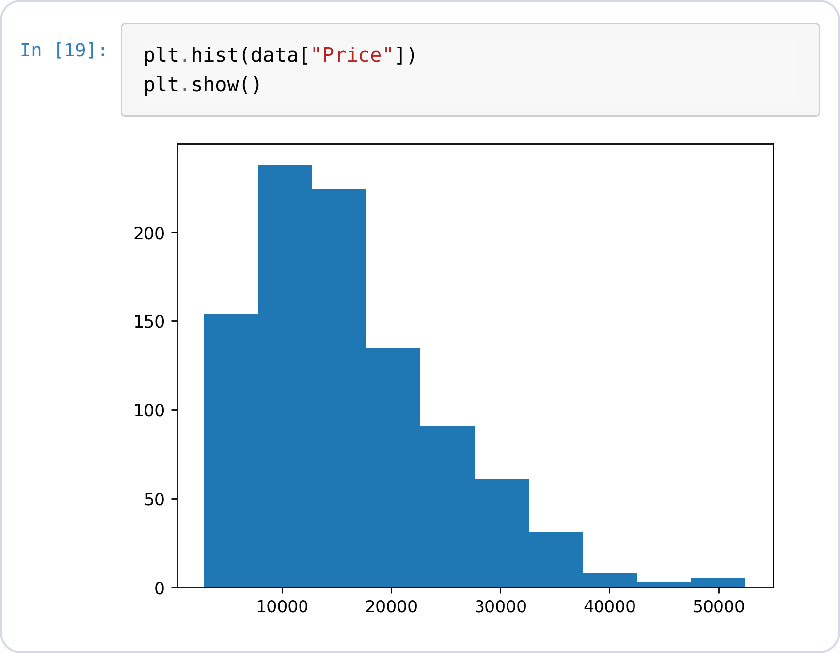
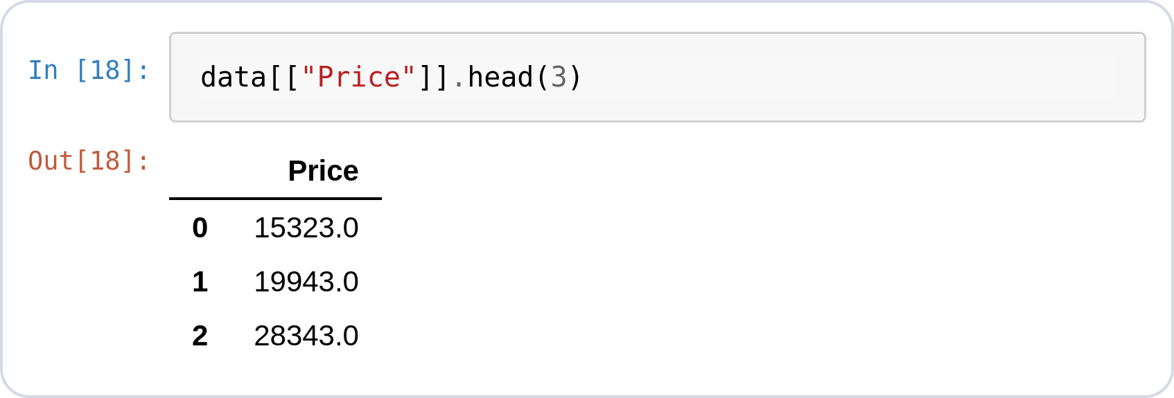
Histogram · Basic Plot
HISTOGRAM · MATPLOTLIB
One raw column in
plt.hist(column) buckets values into bins
10 bins by default and counts each bucket.
No prep needed — the input on the left is the raw Price column.
The right tail shows a few expensive outlier cars.
Notes:
data[["Price"]].head(3)
plt.hist(data["Price"])
plt.show()

Slide 27
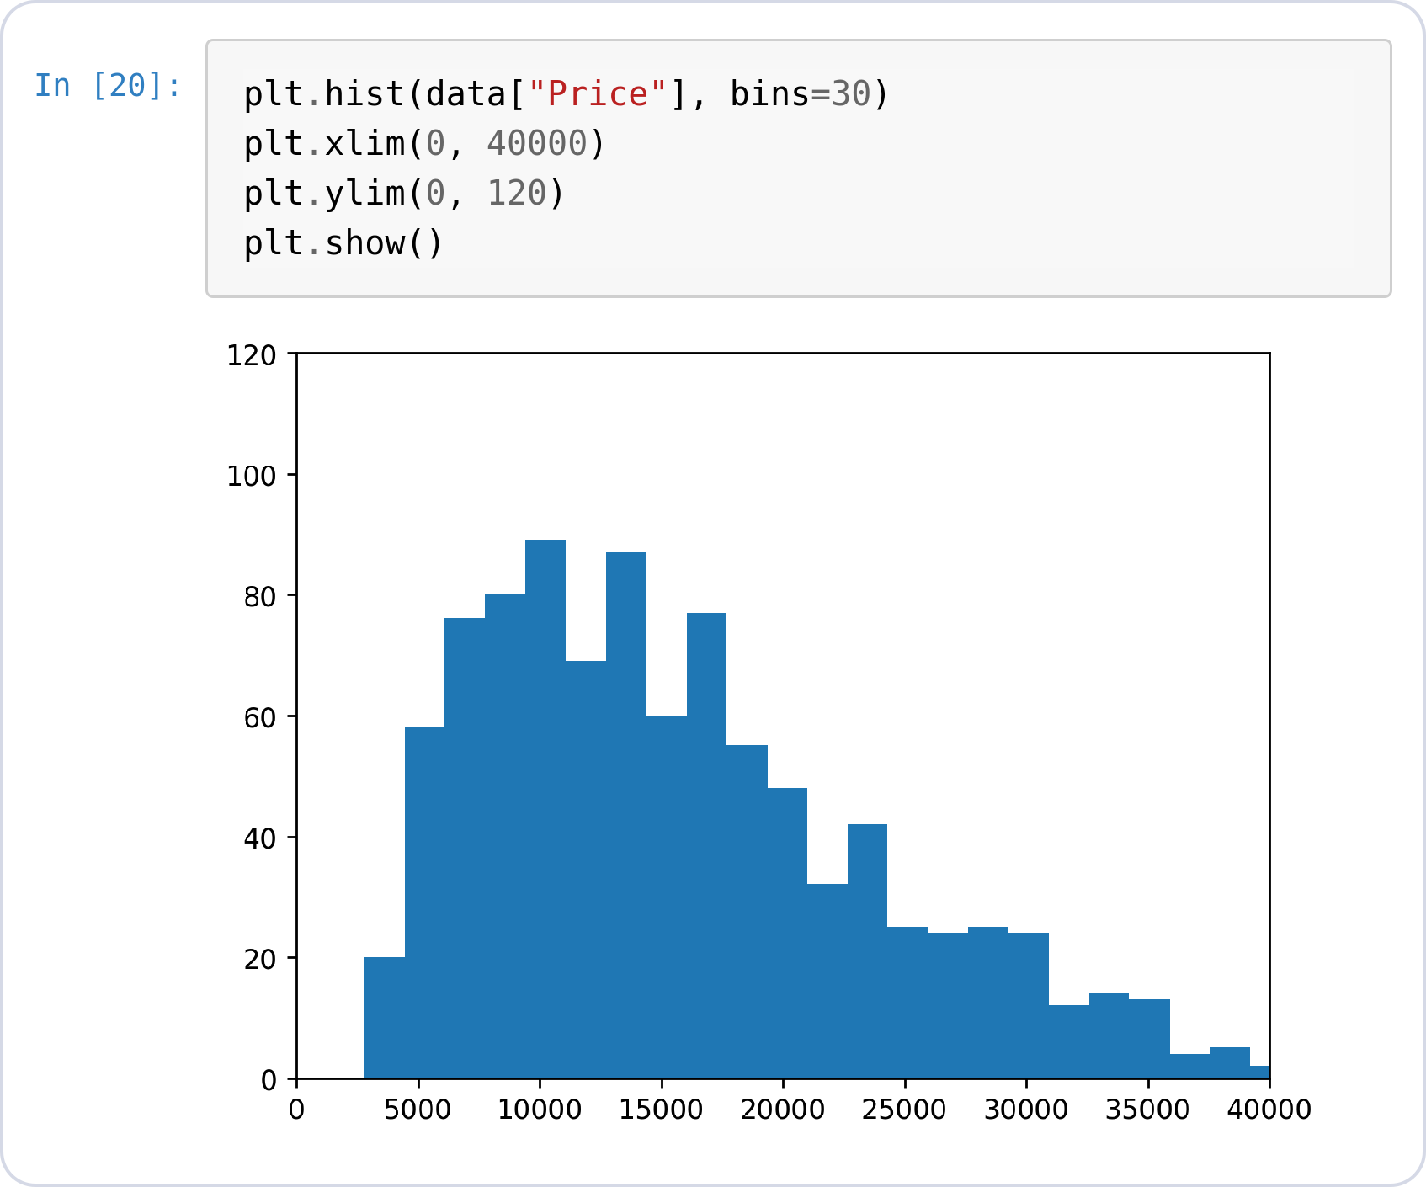
Bins & Axis Ranges
HISTOGRAM · MATPLOTLIB
Controlling the view
bins=30 — more bins, finer detail.
plt.xlim / plt.ylim clip the axes to the region you care about.
Zooming to 0–40,000 drops the outlier tail from view.
Notes:
data[["Price"]].head(3)
plt.hist(data["Price"], bins=30)
plt.xlim(0, 40000)
plt.ylim(0, 120)
plt.show()

Slide 28
Histogram with Seaborn

Slide 29
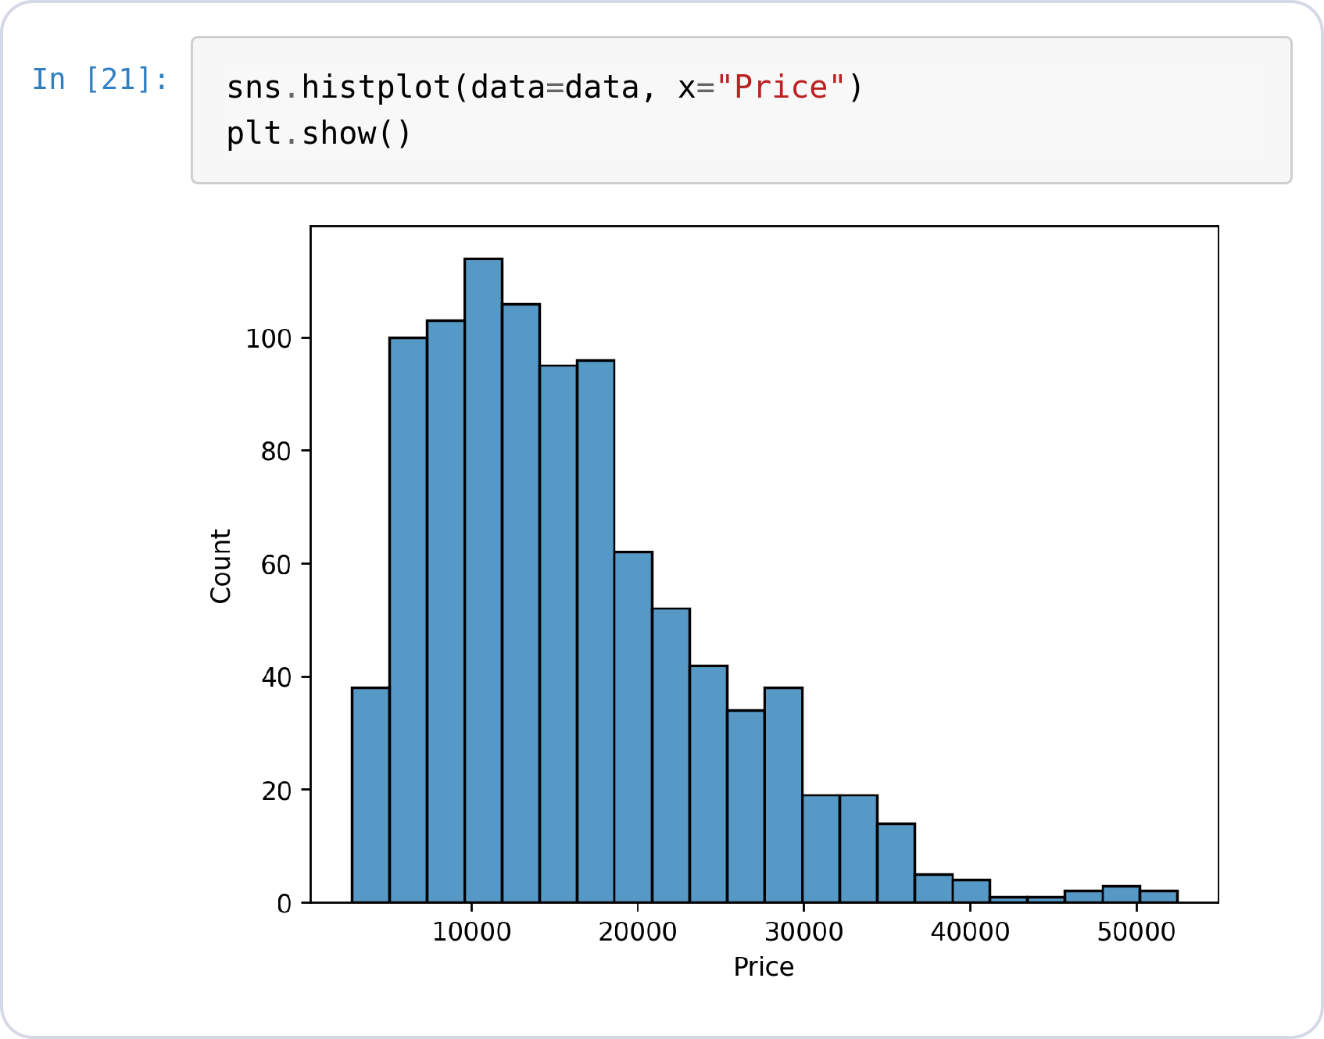
Histogram · Seaborn
HISTOGRAM · SEABORN
Same idea, nicer defaults
sns.histplot(data=..., x=...) — DataFrame plus a column name, not an extracted array.
Sensible bin count, labeled axes, styled bars — for free.
Notes:
data[["Price"]].head(3)
sns.histplot(data=data, x="Price")
plt.show()

Slide 30
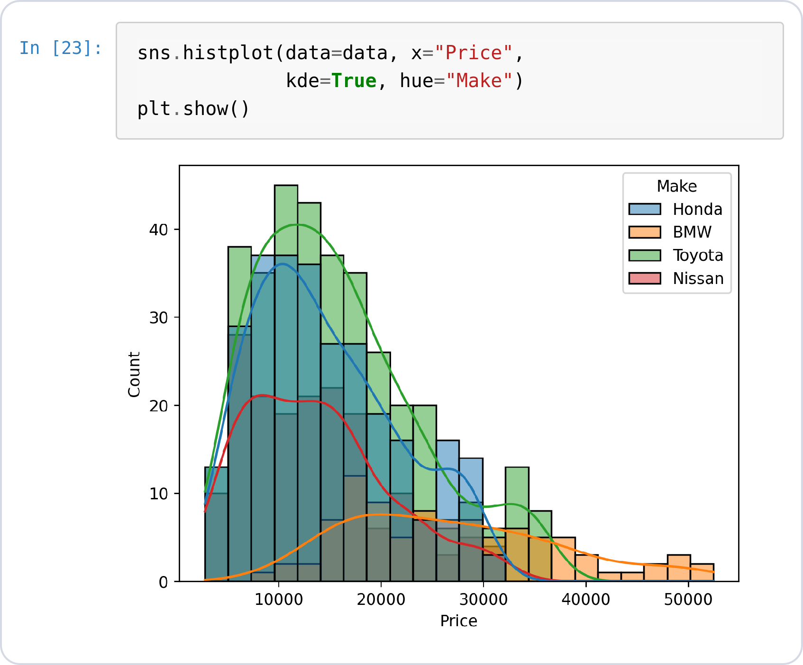
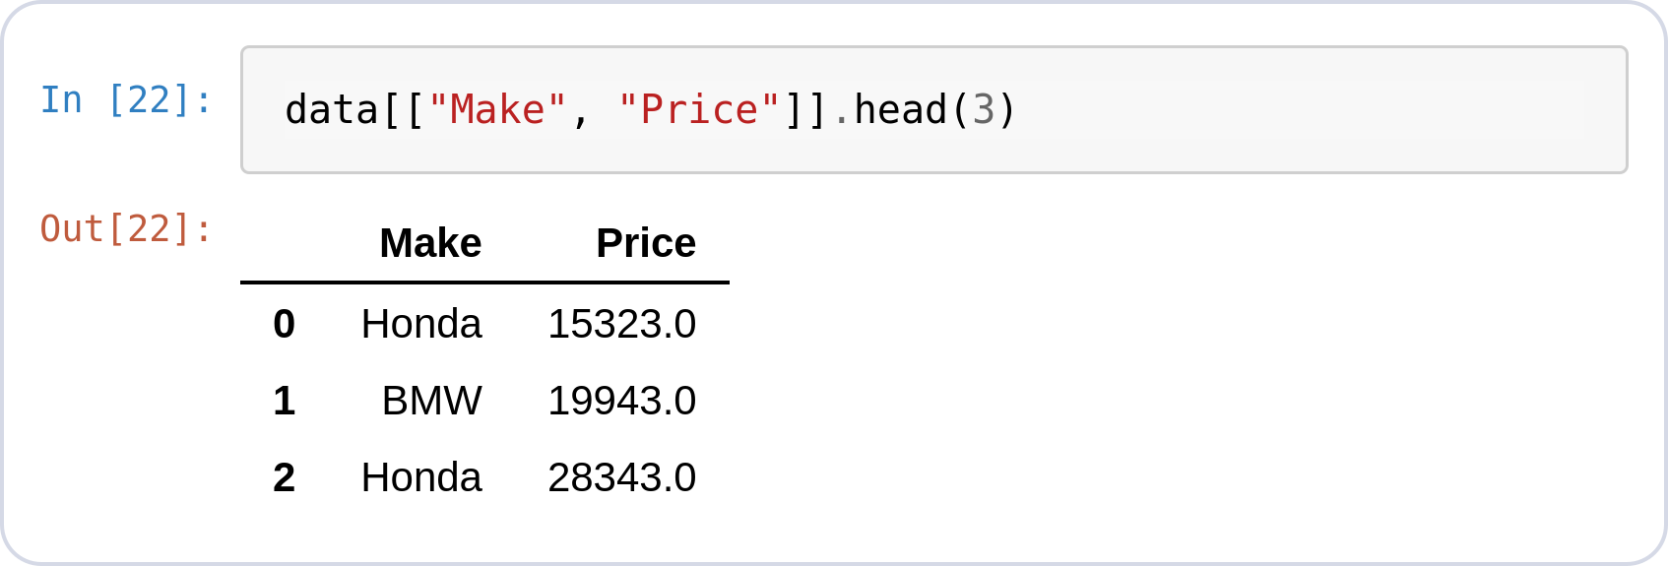
KDE + Groups
HISTOGRAM · SEABORN
Where Seaborn pulls ahead
kde=True overlays a smooth density curve on the bars.
hue="Make" splits the histogram per maker — note the input now carries the Make column.
Doing this in Matplotlib means loops and manual legends.
Notes:
data[["Make", "Price"]].head(3)
sns.histplot(data=data, x="Price",
kde=True, hue="Make")
plt.show()

Slide 31
Scatter Plot
SECTION 04
Relationship between two numerics — does mileage push the price down?

Slide 32
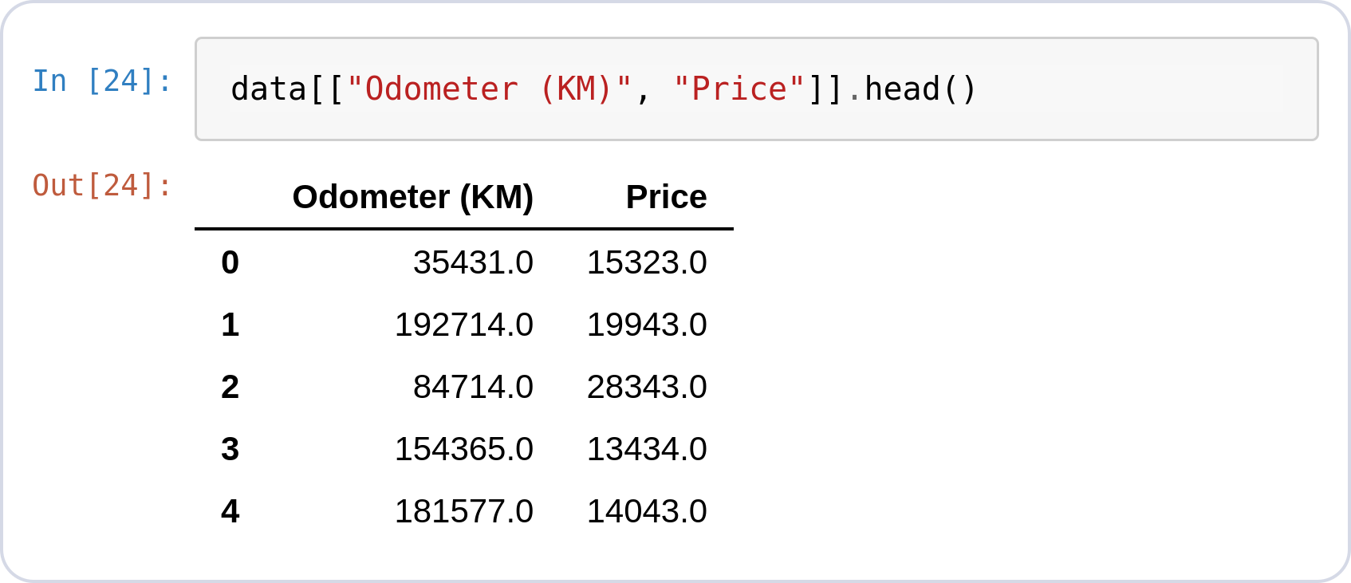
Why a Scatter Plot?
SCATTER · THE QUESTION
Two numbers per car
Buyers assume high mileage means a cheaper car — does the data agree?
Does price fall as the odometer rises, and how strong is the link?
Do different manufacturers follow the same pattern?
● Insight: Plot one dot per car with mileage on x and price on y — the shape of the cloud is the answer.
Notes:
data[["Odometer (KM)", "Price"]].head()

Slide 33
Scatterplot with Matplotlib

Slide 34
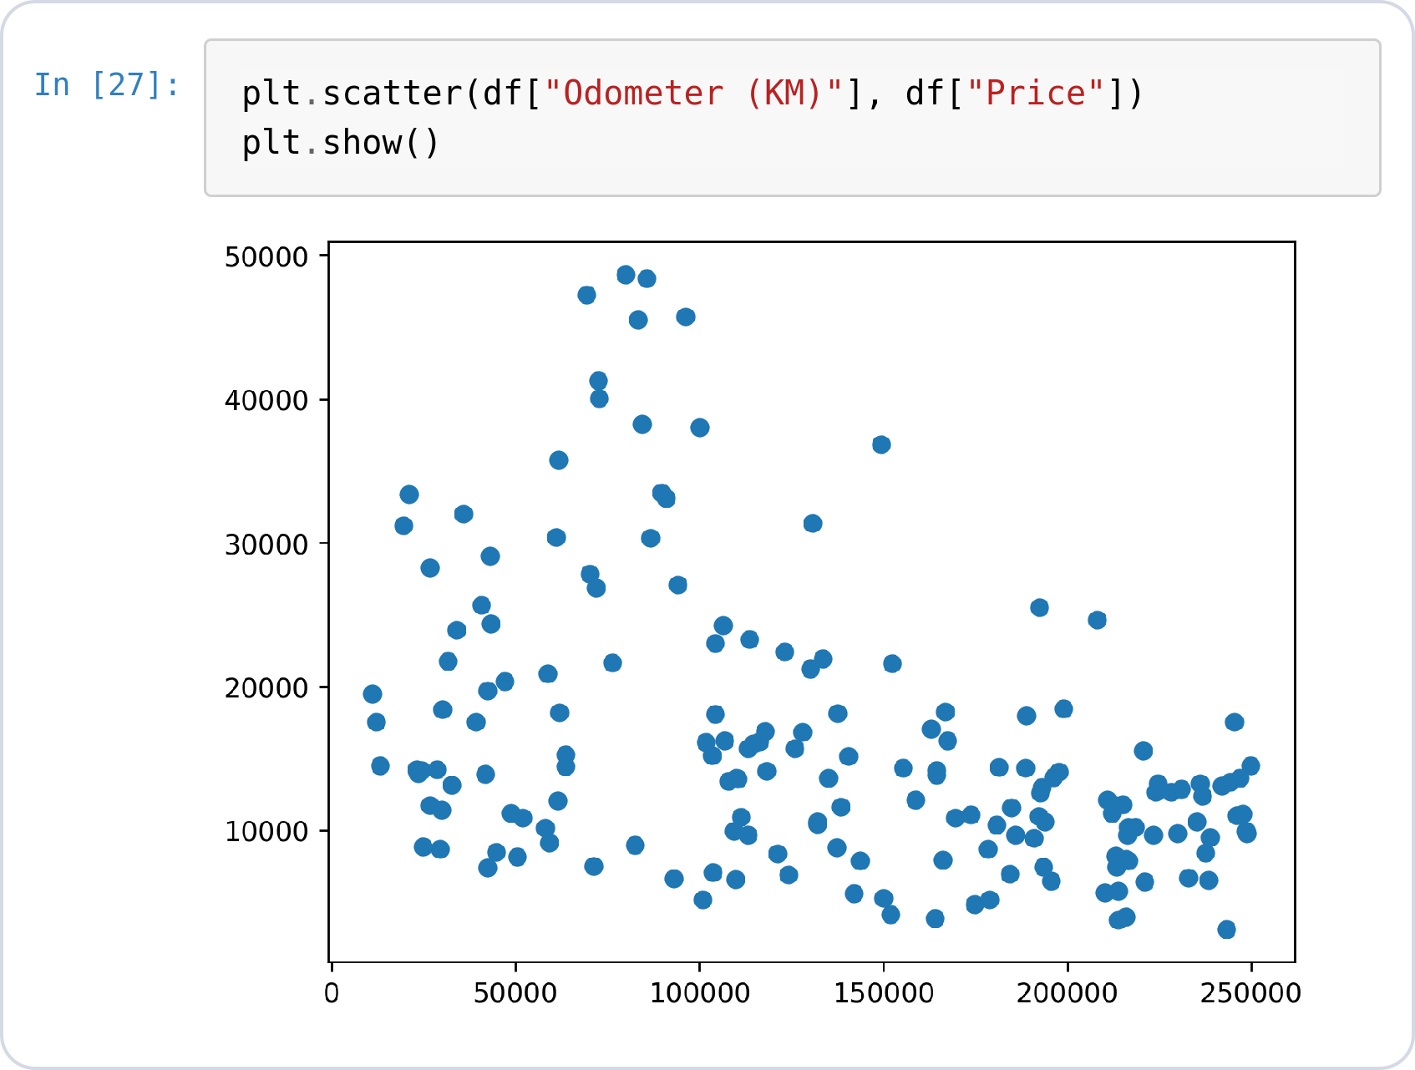
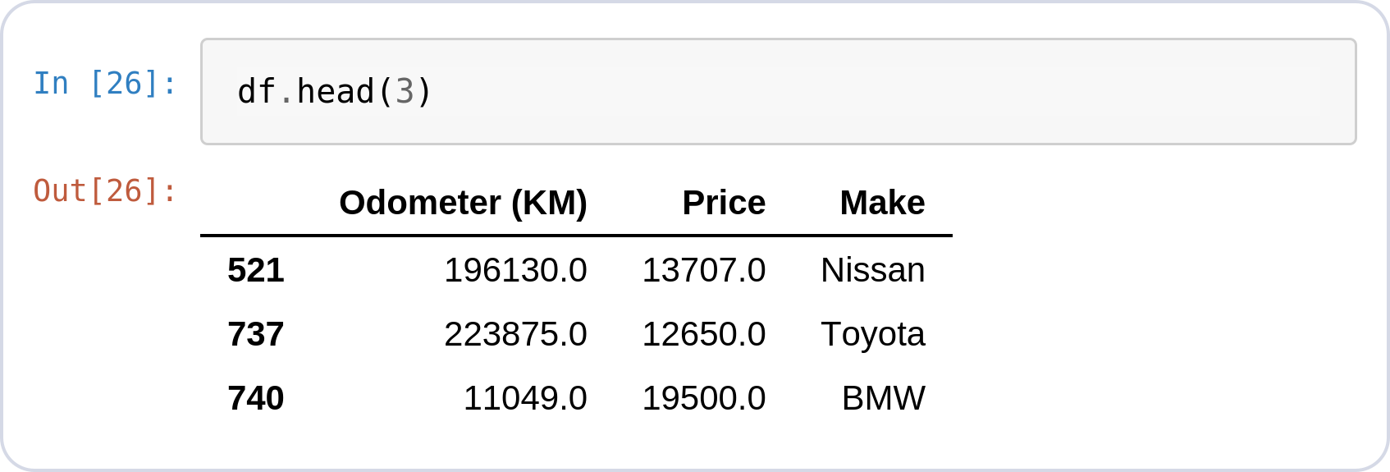
Scatter · Basic Plot
SCATTER · MATPLOTLIB
x column vs y column
plt.scatter(x, y) — one dot per row of the table on the left.
Clear downward trend: more kilometers, lower price.
Notes:
df.head(3)
plt.scatter(df["Odometer (KM)"], df["Price"])
plt.show()

Slide 35
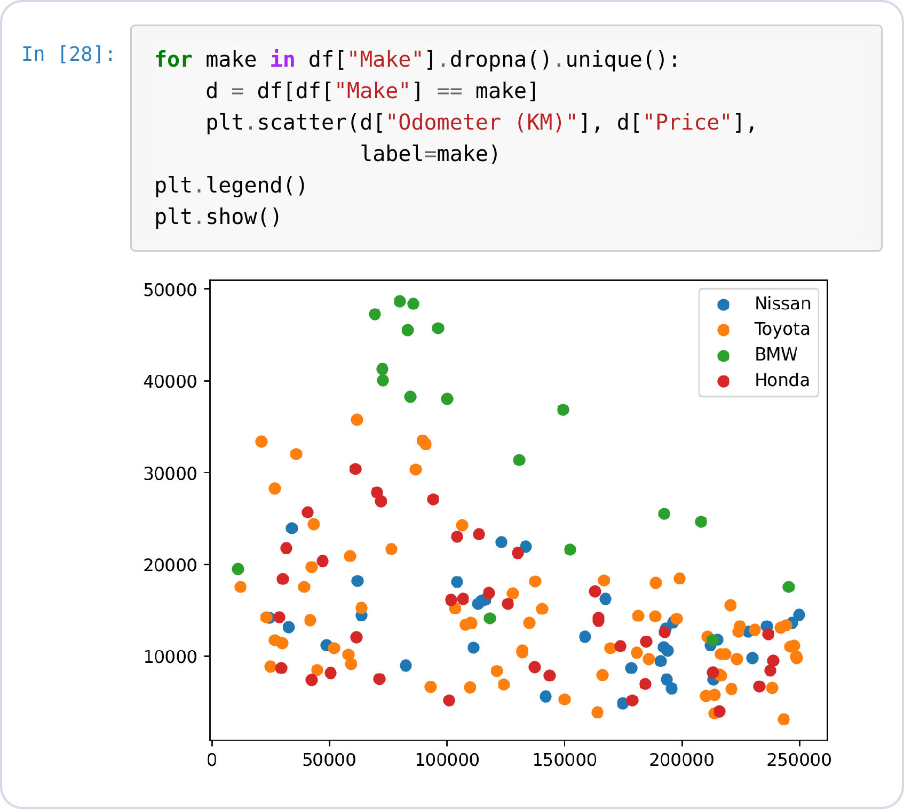
Color by Category
SCATTER · MATPLOTLIB
The manual way
Matplotlib has no hue concept like Seaborn — you loop over categories and call scatter once per maker.
label= + plt.legend() assembles the legend by hand.
Remember this loop: Seaborn deletes it next slide.
Notes:
df.head(3)
for make in df["Make"].dropna().unique():
d = df[df["Make"] == make]
plt.scatter(d["Odometer (KM)"], d["Price"],
label=make)
plt.legend()
plt.show()

Slide 36
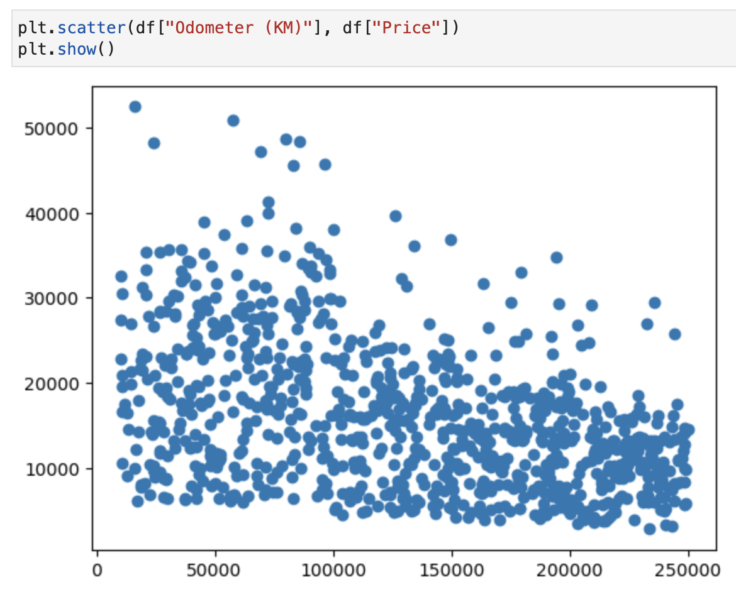
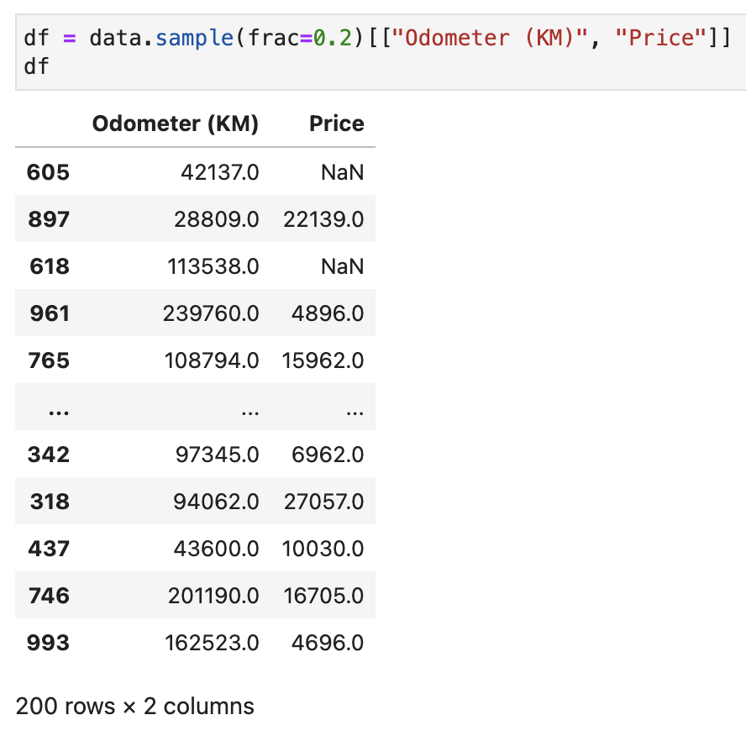
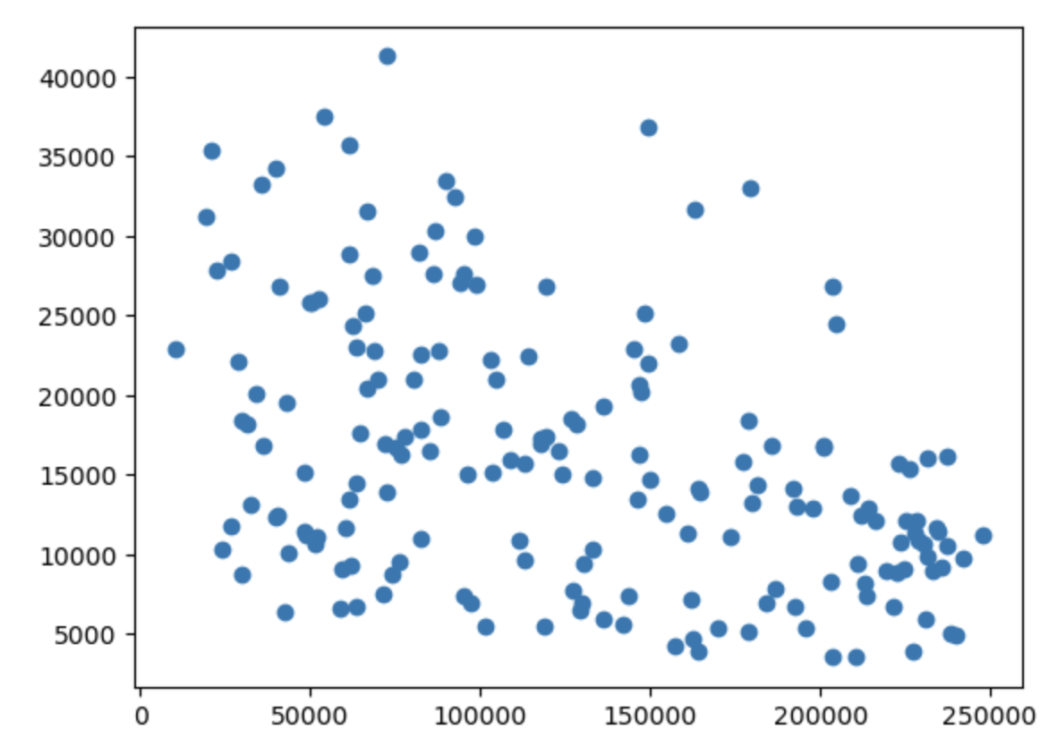
Sampling Dataset for smaller size

Slide 37
Scatterplot with Seaborn

Slide 38
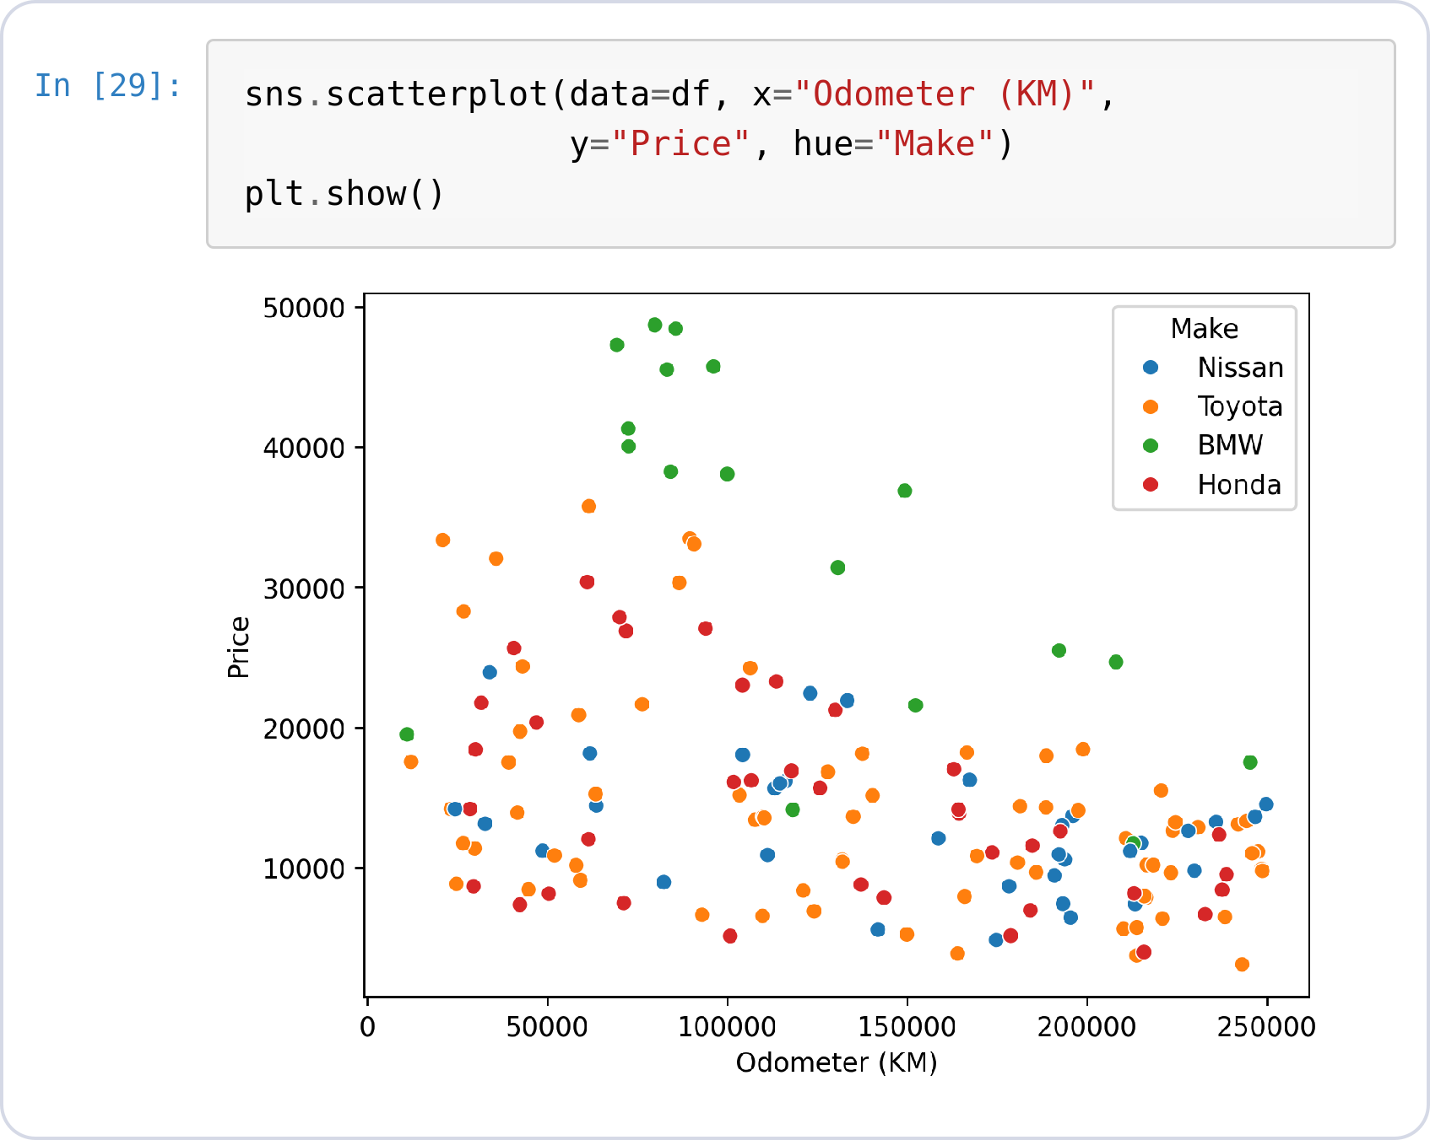
Scatter · Seaborn
SCATTER · SEABORN
hue replaces the loop
hue="Make" colors the points per maker — one line instead of a for-loop.
Legend, palette, axis labels: automatic.
Same input table, a third of the code.
● Insight: hue also works on histplot, lineplot, boxplot… learn it once, use it everywhere.
Notes:
df.head(3)
sns.scatterplot(data=df, x="Odometer (KM)",
y="Price", hue="Make")
plt.show()

Slide 39
Line Chart
SECTION 05
A value over time — how loan interest rates moved through 2018.

Slide 40
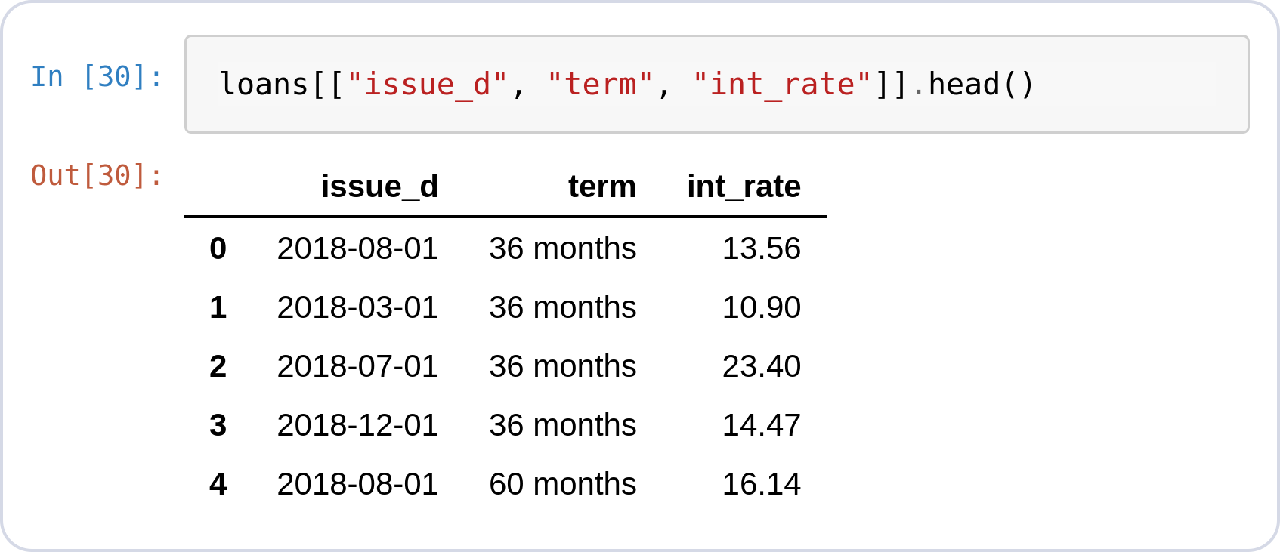
Why a Line Chart?
LINE CHART · THE QUESTION
49,523 loans, one per row
The rows arrive in no particular order, so any trend over the year is hidden.
Did interest rates rise or fall through 2018?
Do 36-month and 60-month loans move together?
● Insight: Average the rate per month, then connect the months in order — that is a line chart.
Notes:
loans[["issue_d", "term", "int_rate"]].head()

Slide 41
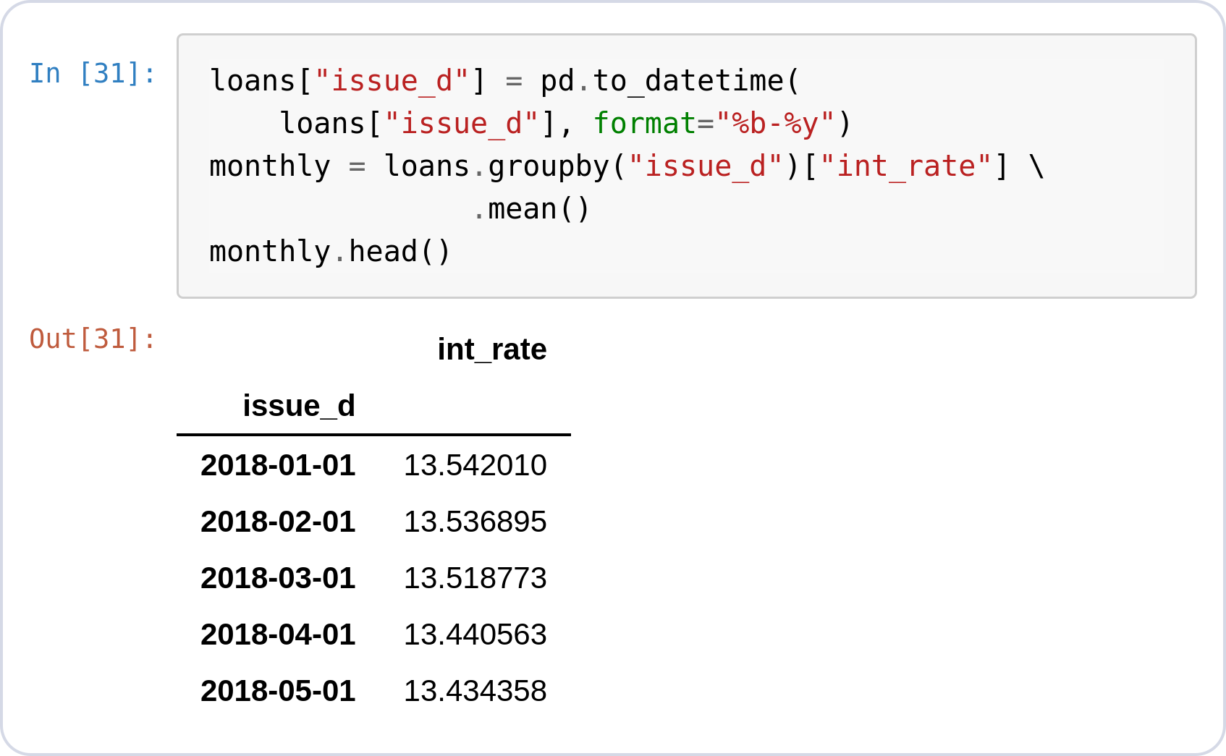
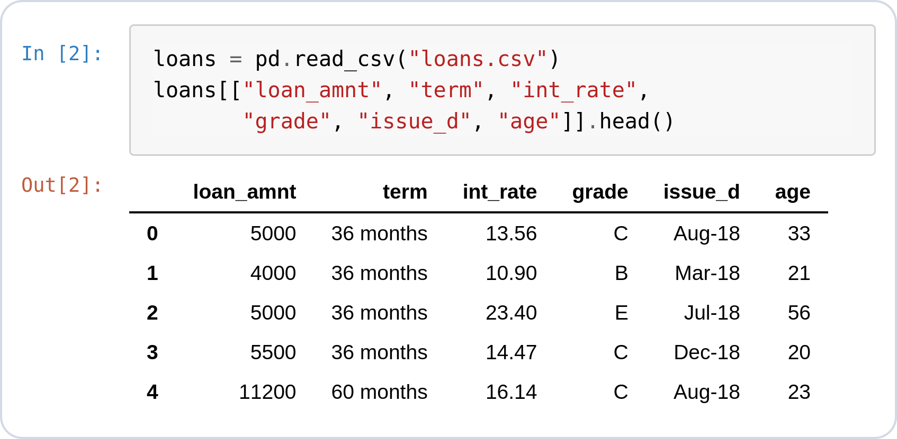
Prepare the Data
LINE CHART · MATPLOTLIB
Original → expected format
pd.to_datetime turns "Aug-18" into real dates.
groupby("issue_d").mean() — one rate per month.
49,523 rows in, 12 rows out.
Notes:
loans = pd.read_csv("loans.csv")
loans[["loan_amnt", "term", "int_rate",
"grade", "issue_d", "age"]].head()
loans["issue_d"] = pd.to_datetime(
loans["issue_d"], format="%b-%y")
monthly = loans.groupby("issue_d")["int_rate"] \
.mean()
monthly.head()

Slide 42
Line Chart with Matplotlib

Slide 43
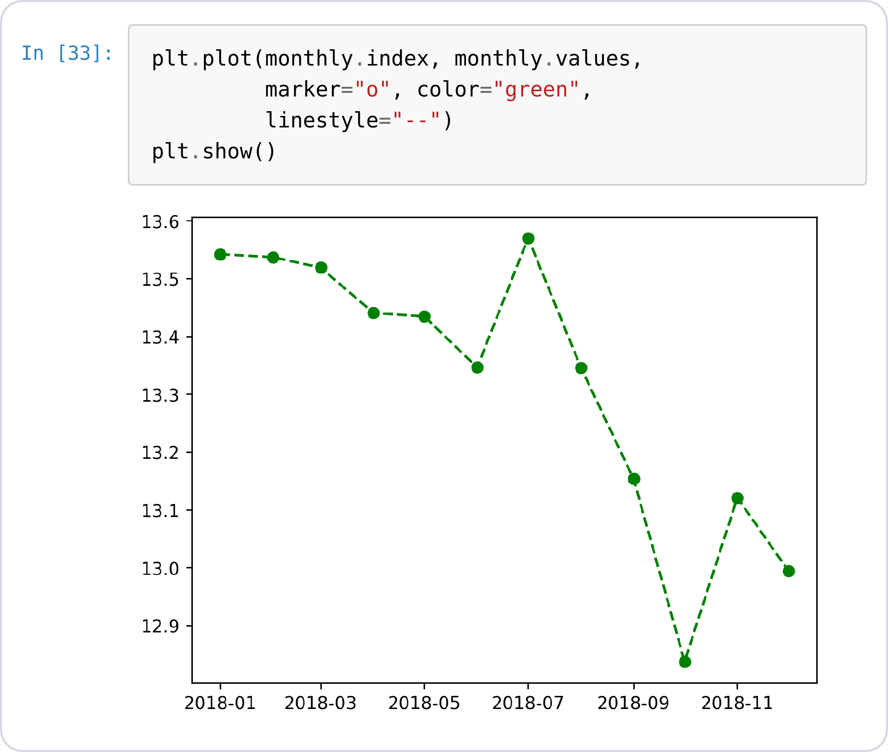
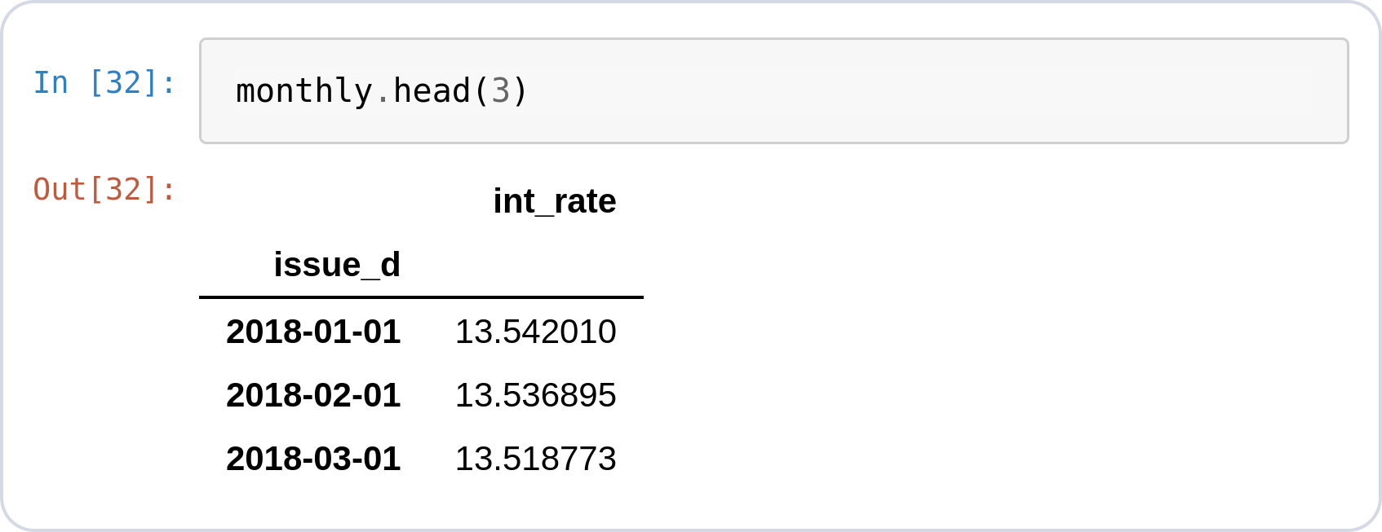
Line · Basic Plot
LINE CHART · MATPLOTLIB
Markers, color, line style
plt.plot(x, y) connects the monthly points on the left in order.
marker="o" dots each data point;
linestyle="--" dashes the line, other linestyle("-*", "-o");
color= names any color.
Notes:
monthly.head(3)
plt.plot(monthly.index, monthly.values,
marker="o", color="green",
linestyle="--")
plt.show()

Slide 44
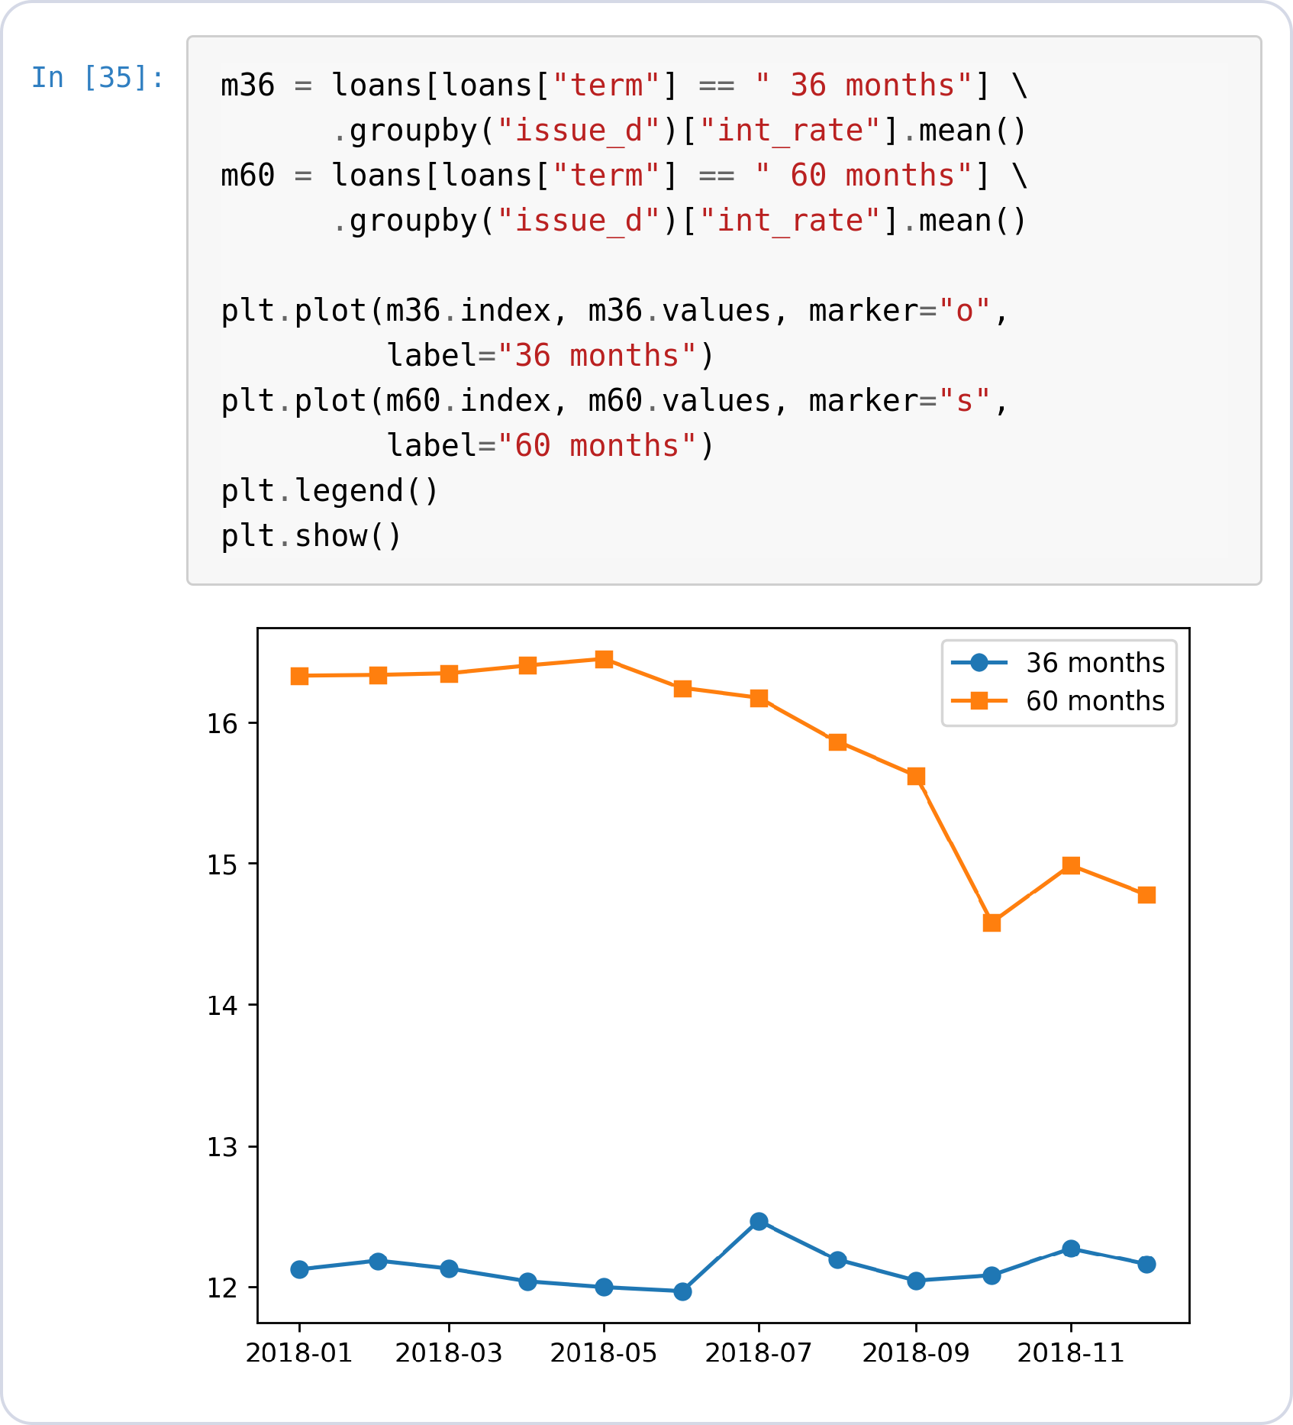
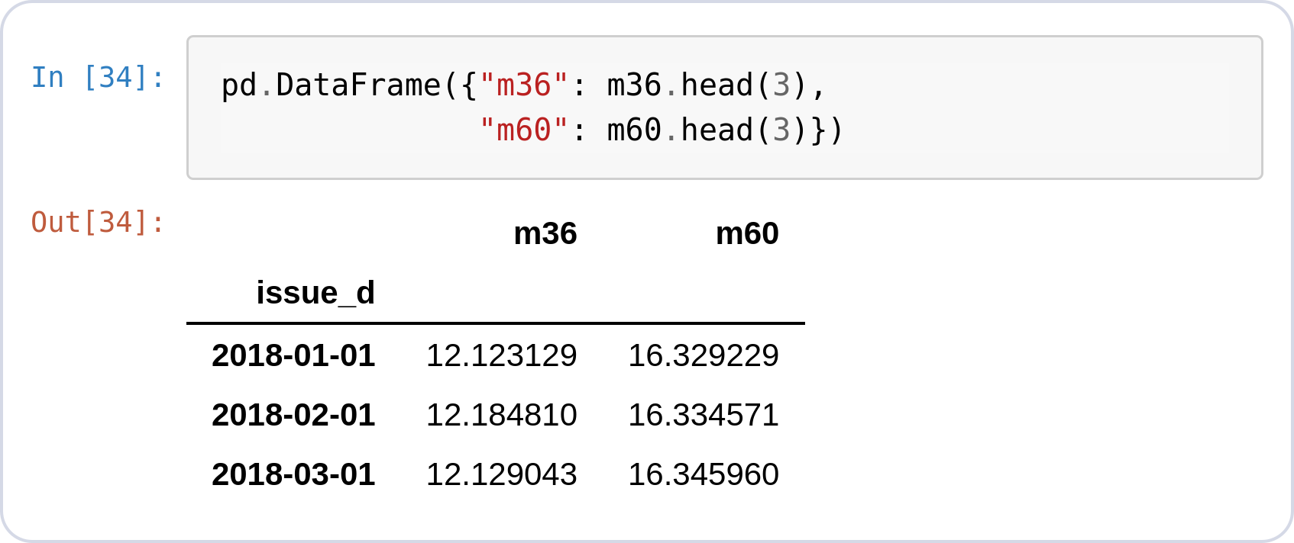
Line · Multiple Series
LINE CHART · MATPLOTLIB
One plot call per line
Filter, aggregate, and plot each term separately — 36 vs 60-month loans.
plt.legend() collects the labels.
Two prepared Series on the left → two lines on the right.
Notes:
pd.DataFrame({"m36": m36.head(3),
"m60": m60.head(3)})
m36 = loans[loans["term"] == " 36 months"] \
.groupby("issue_d")["int_rate"].mean()
m60 = loans[loans["term"] == " 60 months"] \
.groupby("issue_d")["int_rate"].mean()
plt.plot(m36.index, m36.values, marker="o",
label="36 months")
plt.plot(m60.index, m60.values, marker="s",
label="60 months")
plt.legend()
plt.show()

Slide 45
Line Chart with Seaborn

Slide 46
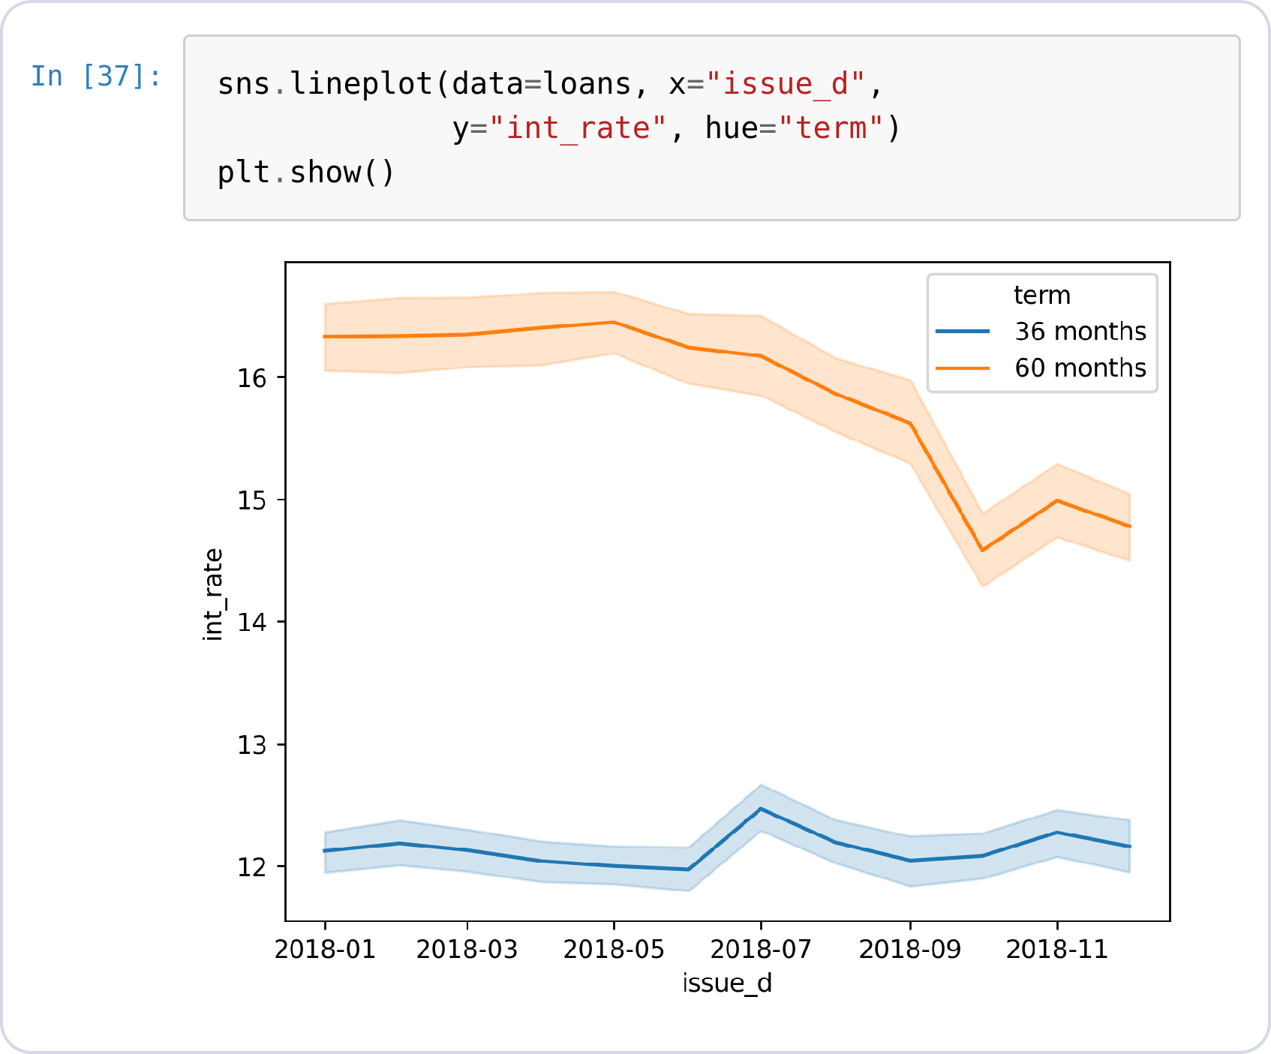
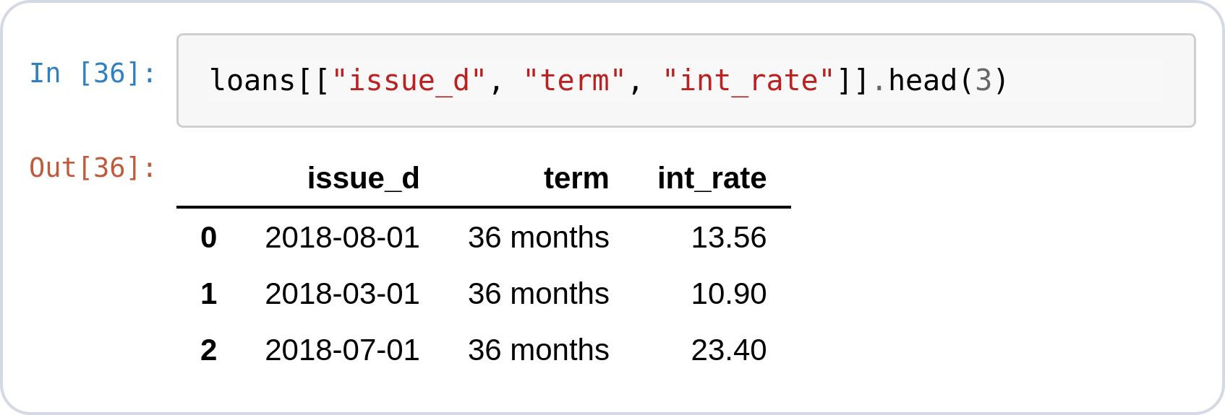
Line · Seaborn
LINE CHART · SEABORN
Raw 49,523 rows straight in
No to_datetime groupby pipeline — sns.lineplot aggregates per month itself.
hue="term" draws both loan terms with a legend.
The shaded band is a 95% confidence interval — free statistics.
● Insight: The band needs the raw rows to compute spread — pre-aggregated data can't produce it.
Notes:
loans[["issue_d", "term", "int_rate"]].head(3)
sns.lineplot(data=loans, x="issue_d",
y="int_rate", hue="term")
plt.show()

Slide 47
Chart Formatting

Slide 48
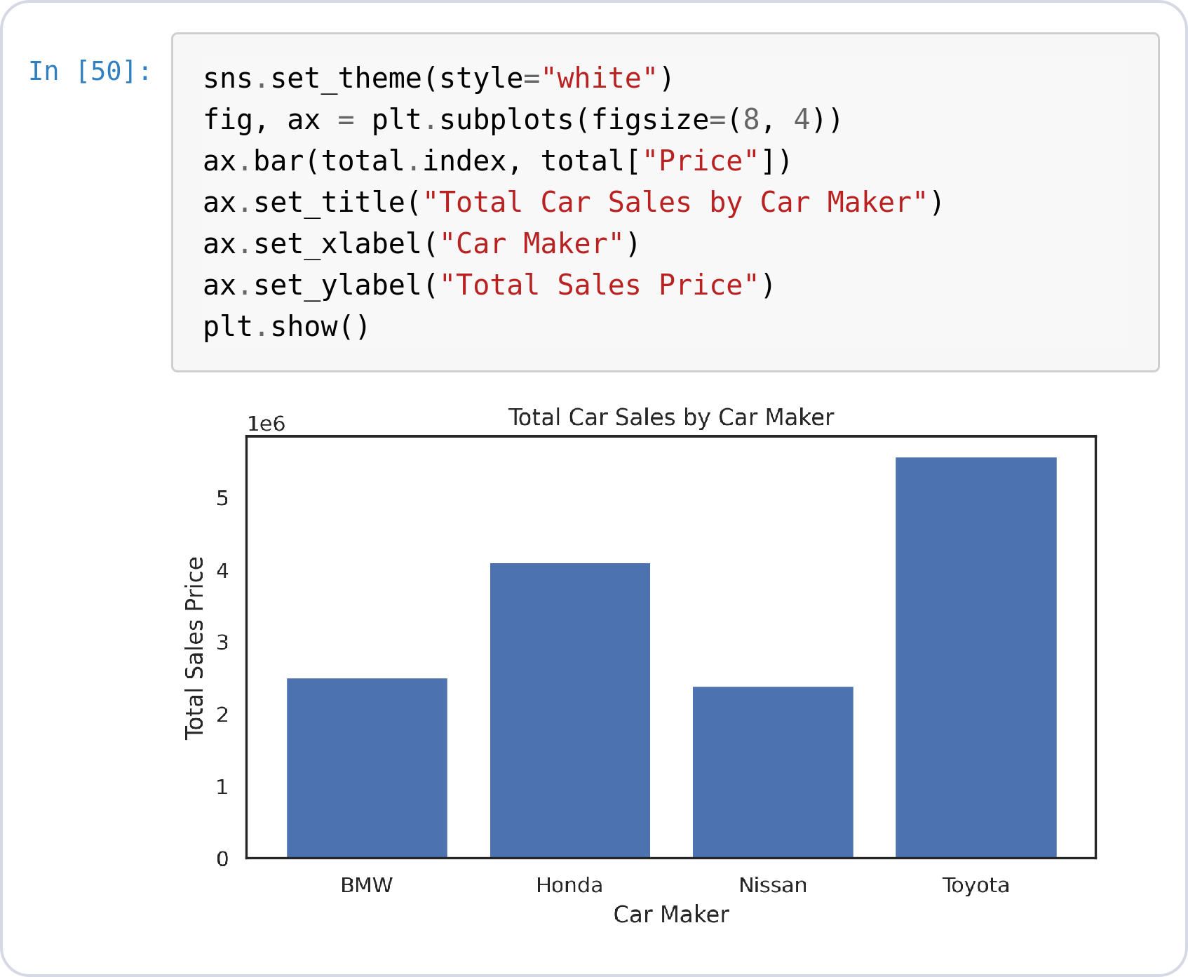
Formatting Any Chart
WORKS FOR BOTH LIBRARIES
Title, labels, size
figsize=(8, 4) sets width × height in inches.
set_title / set_xlabel / set_ylabel — no chart ships without them.
Seaborn charts are Matplotlib axes, so the same calls work on both.
Notes:
total
sns.set_theme(style="white")
fig, ax = plt.subplots(figsize=(8, 4))
ax.bar(total.index, total["Price"])
ax.set_title("Total Car Sales by Car Maker")
ax.set_xlabel("Car Maker")
ax.set_ylabel("Total Sales Price")
plt.show()

Slide 49
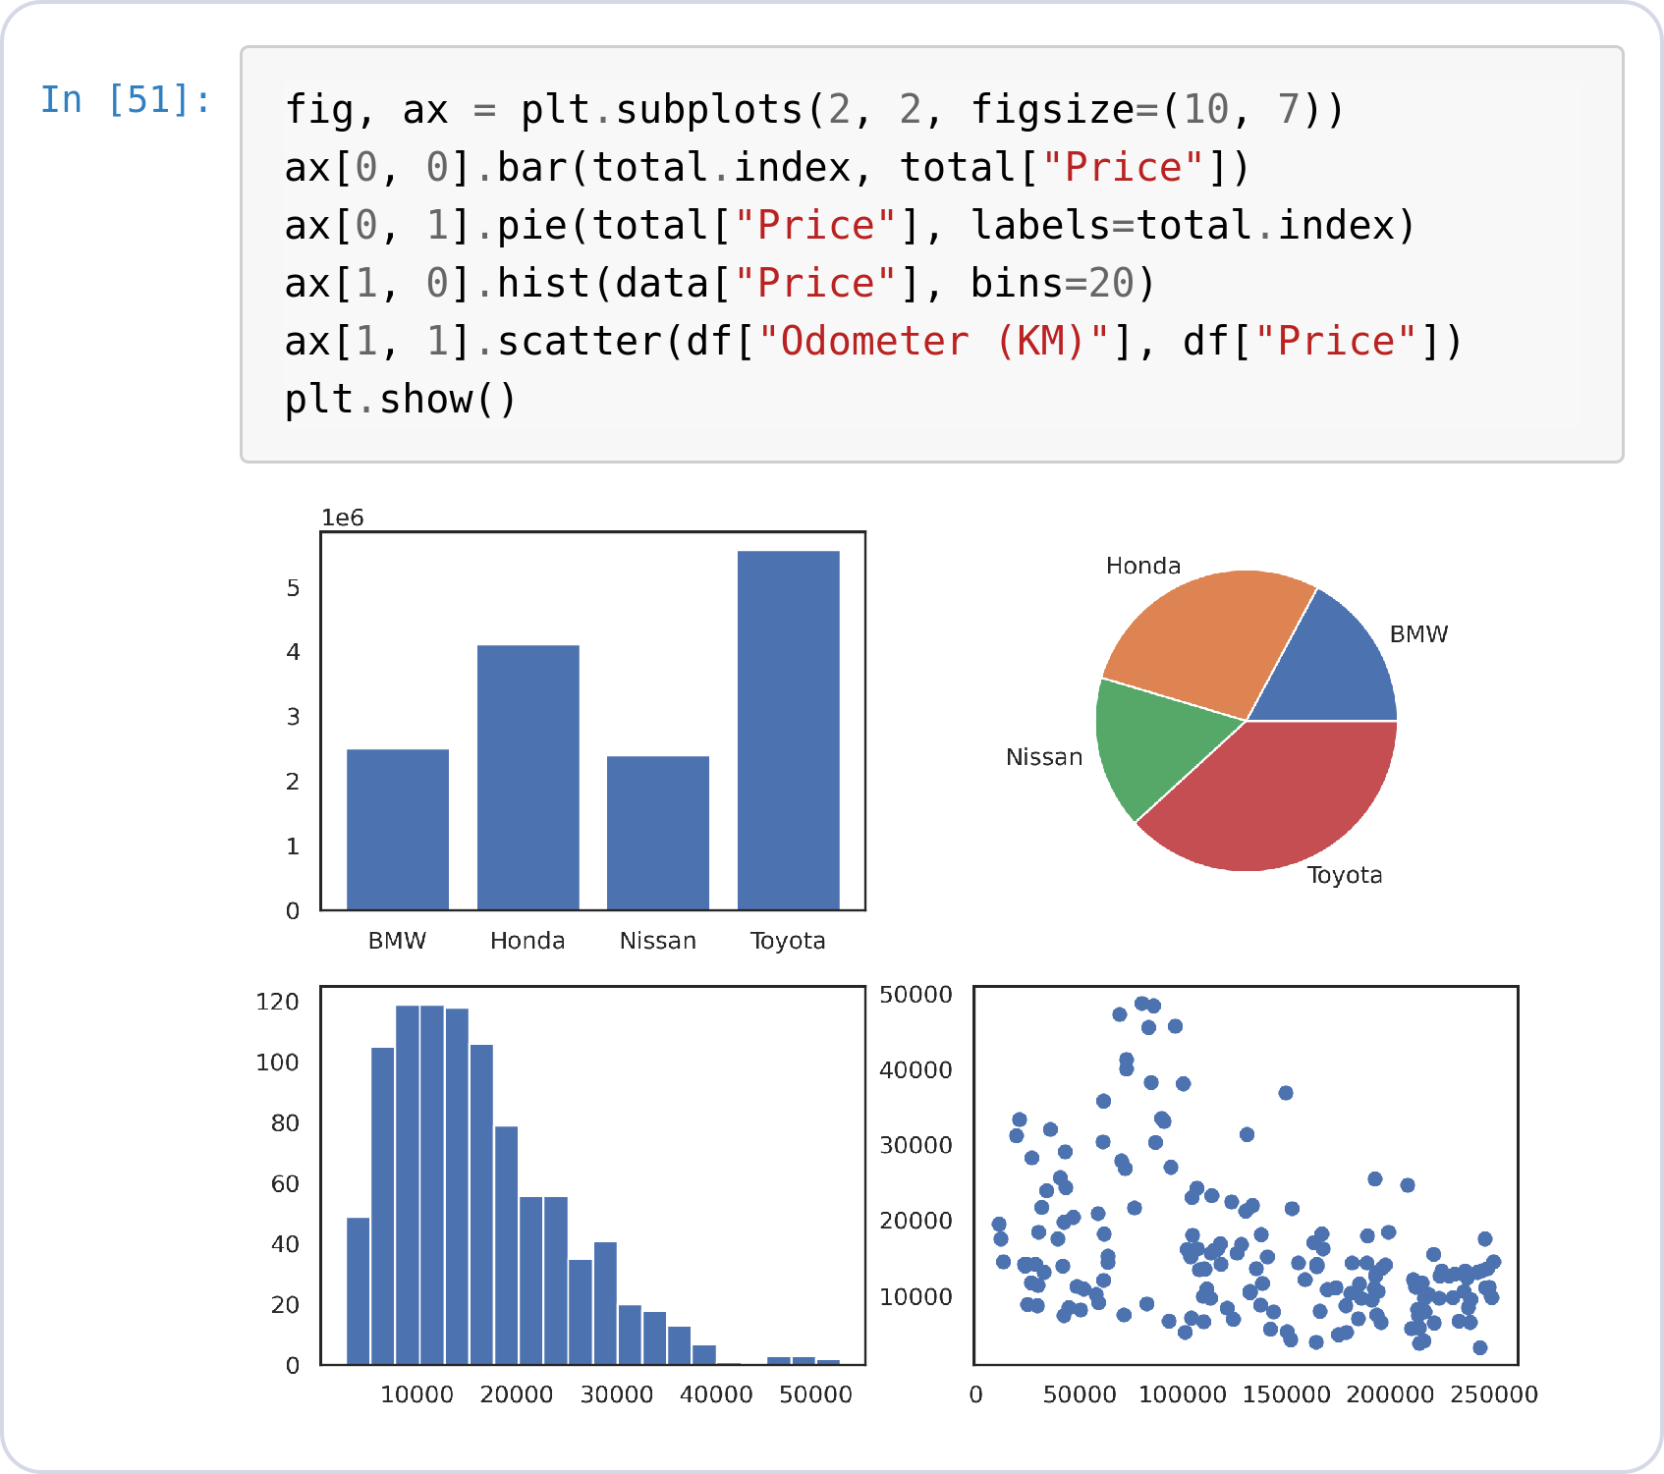
Subplots Dashboard
WORKS FOR BOTH LIBRARIES
One figure, four axes
plt.subplots(2, 2) returns a grid of axes; index with ax[row, col].
Each cell takes any chart from today — a one-figure dashboard.
Notes:
fig, ax = plt.subplots(2, 2, figsize=(10, 7))
ax[0, 0].bar(total.index, total["Price"])
ax[0, 1].pie(total["Price"], labels=total.index)
ax[1, 0].hist(data["Price"], bins=20)
ax[1, 1].scatter(df["Odometer (KM)"], df["Price"])
plt.show()

Slide 50
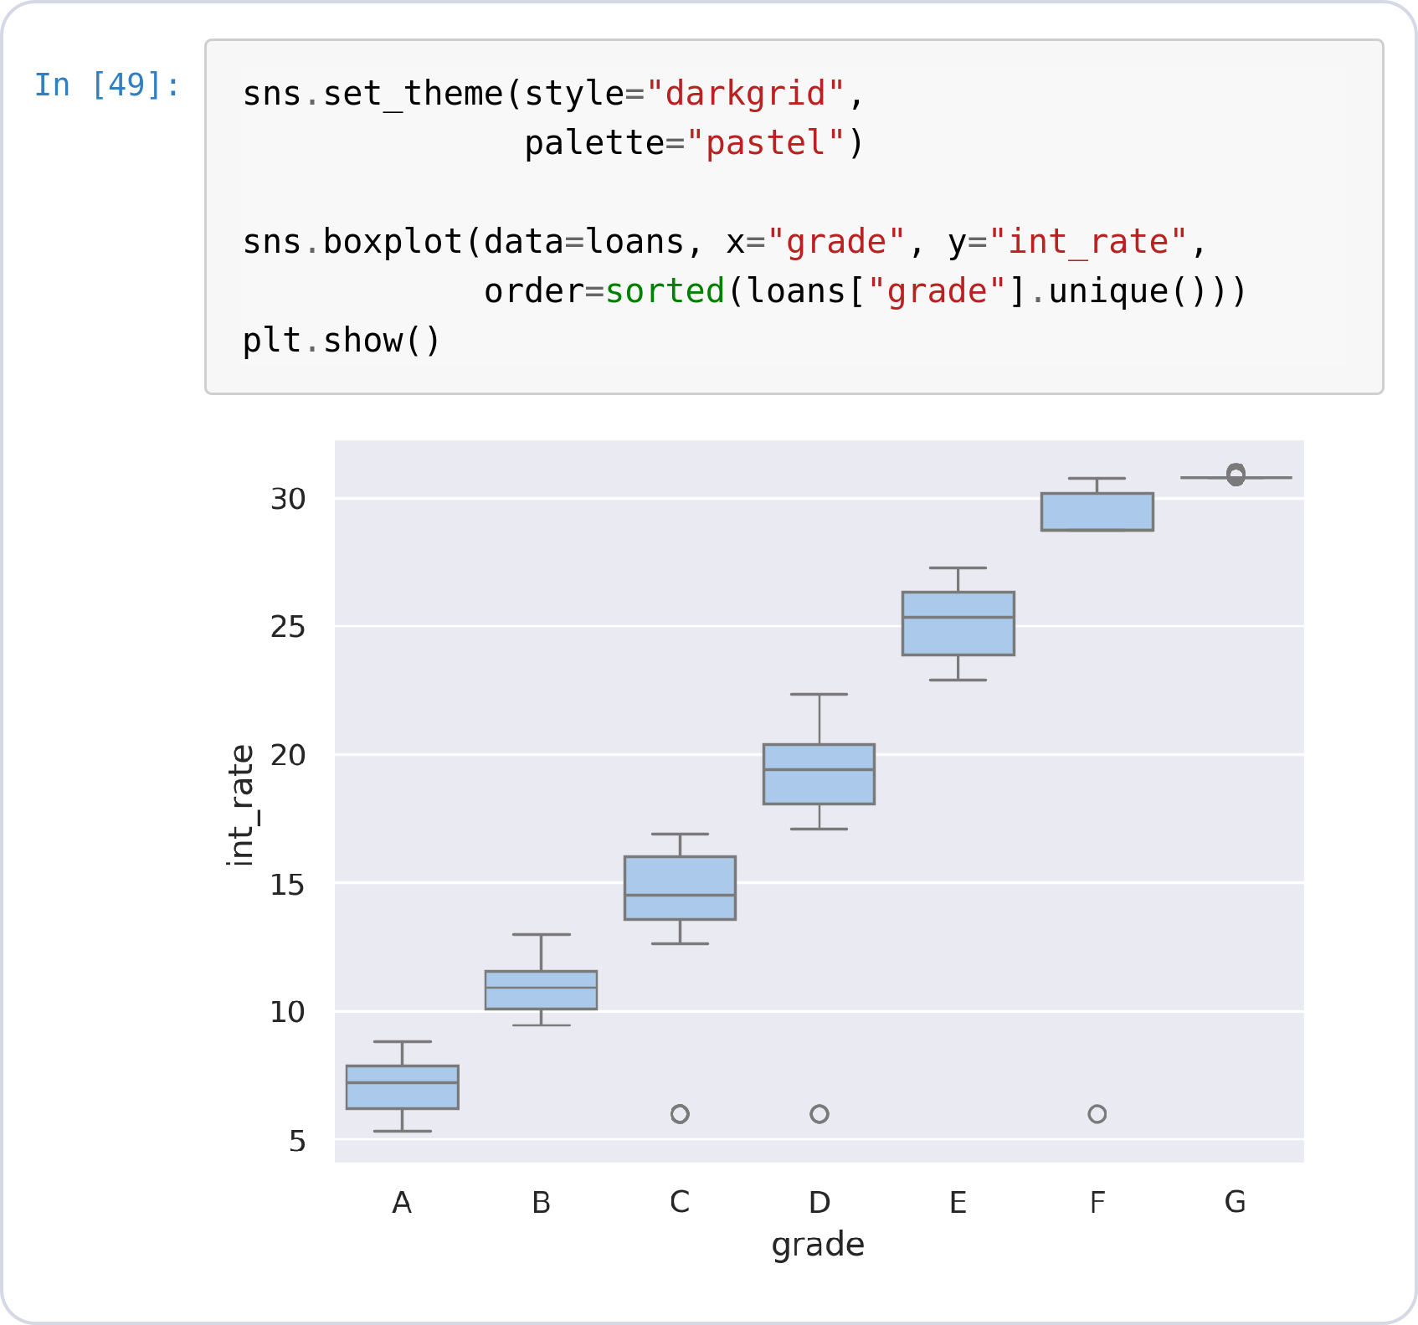
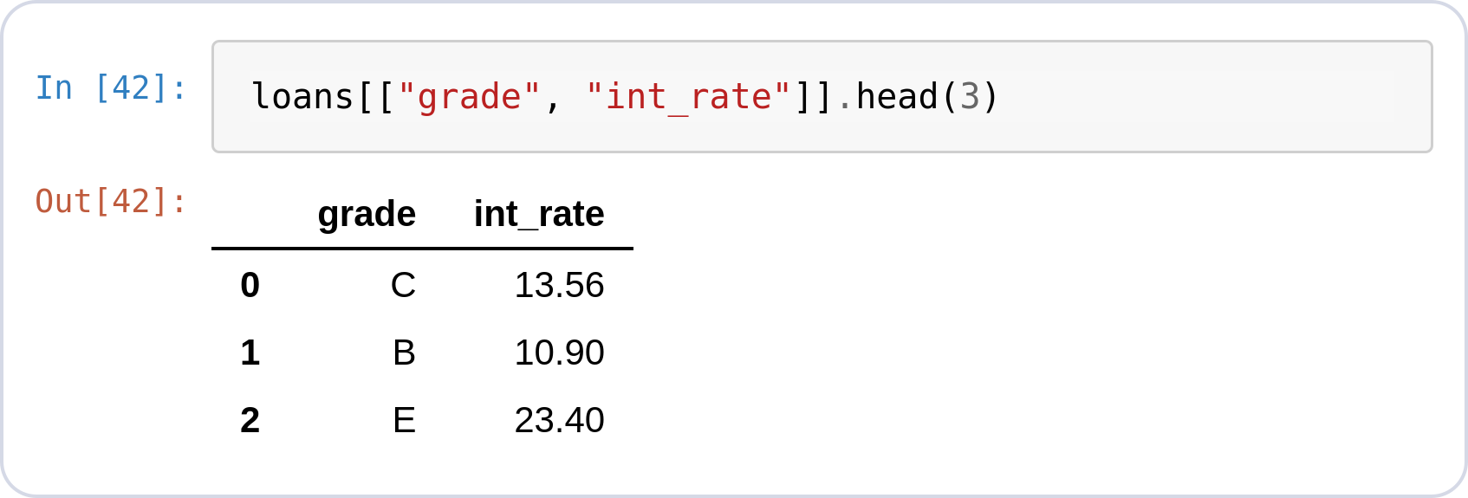
Themes & Palettes
SEABORN EXTRAS
Restyle every chart at once
sns.set_theme() changes the look globally — every later figure inherits it, Matplotlib ones included.
style= controls the background grid; palette= the color cycle.
Same data and same boxplot code — only the theme line changed.
Notes:
loans[["grade", "int_rate"]].head(3)
sns.set_theme(style="darkgrid",
palette="pastel")
sns.boxplot(data=loans, x="grade", y="int_rate",
order=sorted(loans["grade"].unique()))
plt.show()

